Slide 1
Objective
To apply and associate economic concepts with students’ lives

Slide 2
Mixed Economy
Some Government involvement
Competition among businesses
Lower prices, Better products
Consumers have choice
Consumer Sovereignty
Firms produce what we want

Slide 3
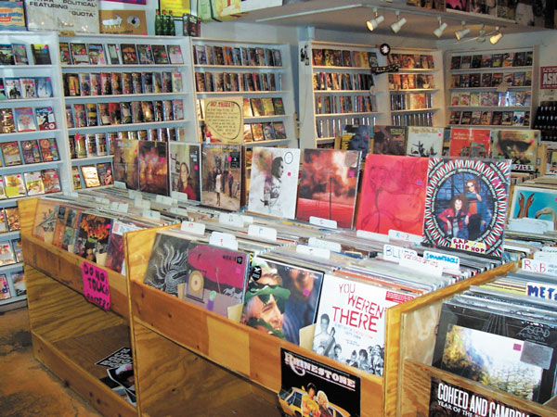
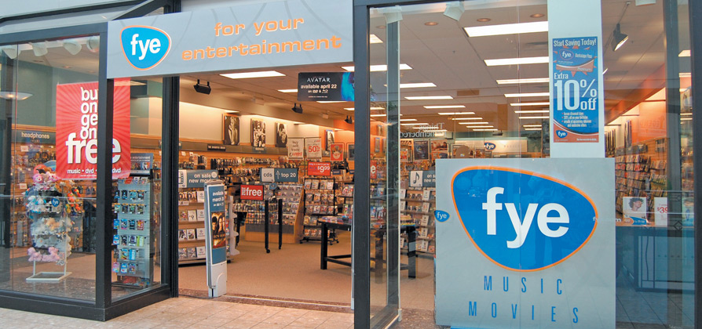

Slide 4
Competition Project
Record Store
Group of 2-4
Create a Band

Slide 5
Competition Project
Design:
Album Cover Front
Band Name
Album Name
Artwork (drawn or printed and pasted)
Album Cover Back
Song Names (at least 10)
Artwork
We will display on the walls
Class will vote
Which record would you purchase
Cannot pick your own

Slide 6
How to Design
On PowerPoint
One Slide (front)
One Slide (back)
Save to G drive – Mr. D will print.
Print by 5 minutes left in class
By hand:
One Sheet of paper (front)
One sheet of paper (back)

Slide 7
The Birds
We Love School

Slide 8
School Rules
Study All Night, Learn Every Day
Math Attack
Science Blues
Gereau Yo!
BFMS BFF
I’m Smart and I know it
Bookworm
Ace That Test
Good Grade, Get Paid
The Birds

Slide 9
Funny Albums & Famous Albums

Slide 11
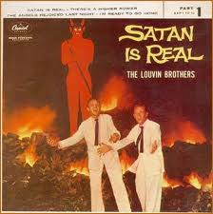

Slide 12
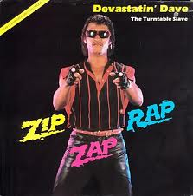

Slide 13
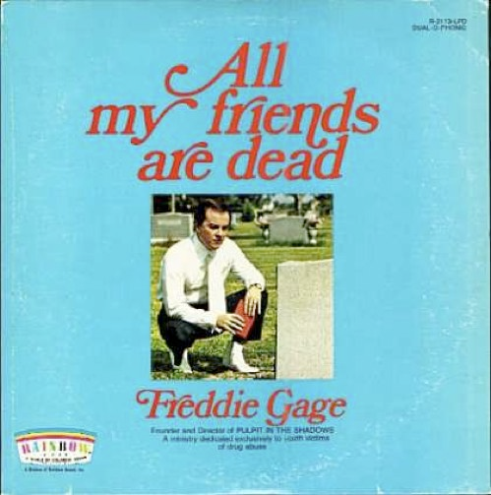

Slide 15
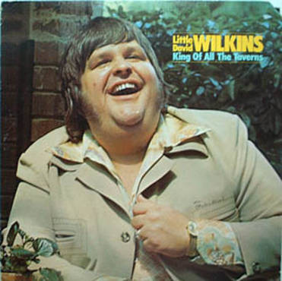

Slide 17
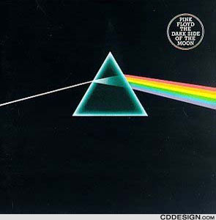

Slide 19
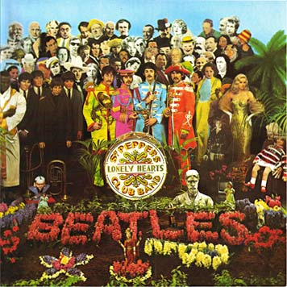

Slide 21
