Slide 1
Bill becomes a law

Slide 2

What is the process for making a law?

Slide 3

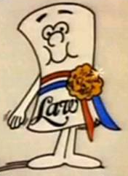

Slide 4


Slide 5
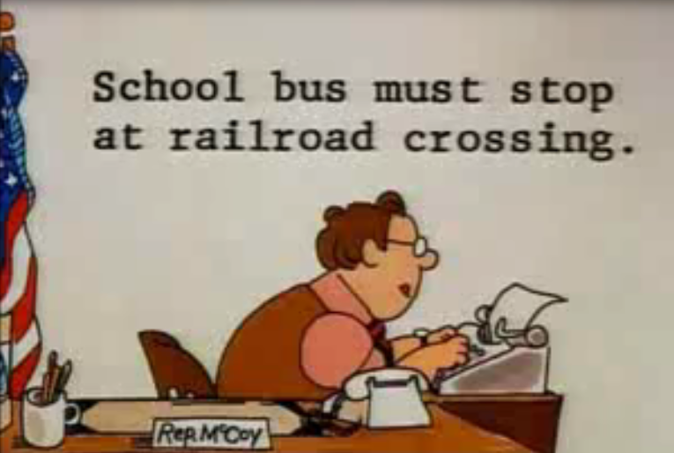
Bill is Proposed

Slide 6
proposed

Slide 7

Bill is Introduced in house #1
Bill

Slide 8
Bill
Introduced in
House #1
proposed

Slide 9
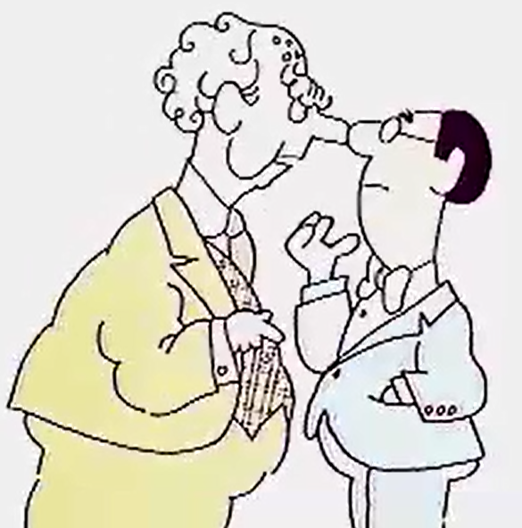

Bill is Sent to a Committee in house #1

Slide 10

Bill
Introduced in
House #1
Sent to Committee
in House #1
proposed

Slide 11
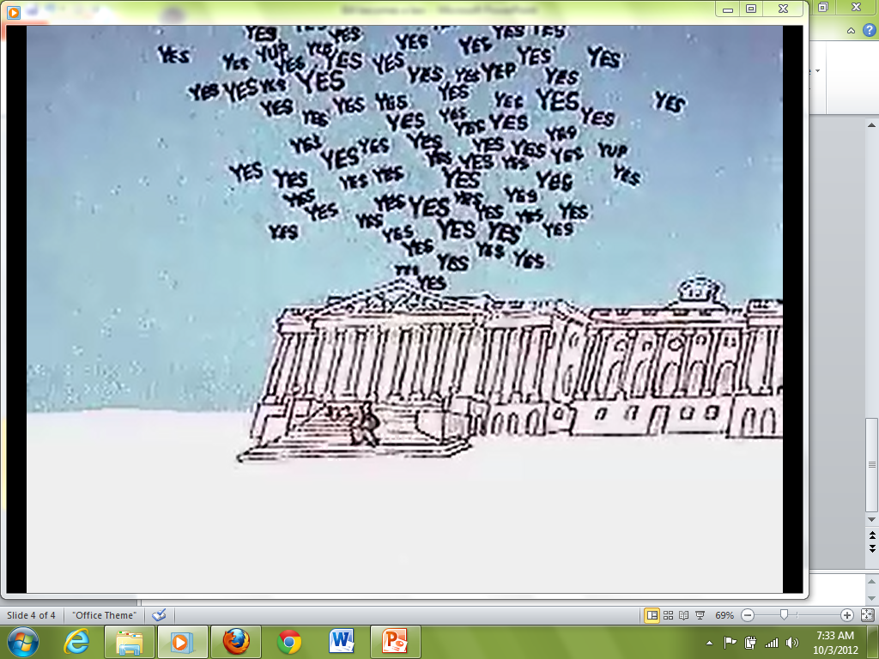
Bill is Debated & Voted on in House #1

Slide 12

Bill
Introduced in
House #1
Sent to Committee
in House #1
Debated & Voted on
in House #1
proposed

Slide 13
Bill is Introduced in house #2
Bill

Slide 14
Bill
Introduced in
House #1
Sent to Committee
in House #1
Debated & Voted on
in House #1
proposed
Bill
Introduced in
House #2

Slide 15
Bill is Sent to a Committee in house #2

Slide 16
Bill
Introduced in
House #1
Sent to Committee
in House #1
Debated & Voted on
in House #1
proposed
Bill
Sent to Committee
in House #2
Introduced in
House #2

Slide 17
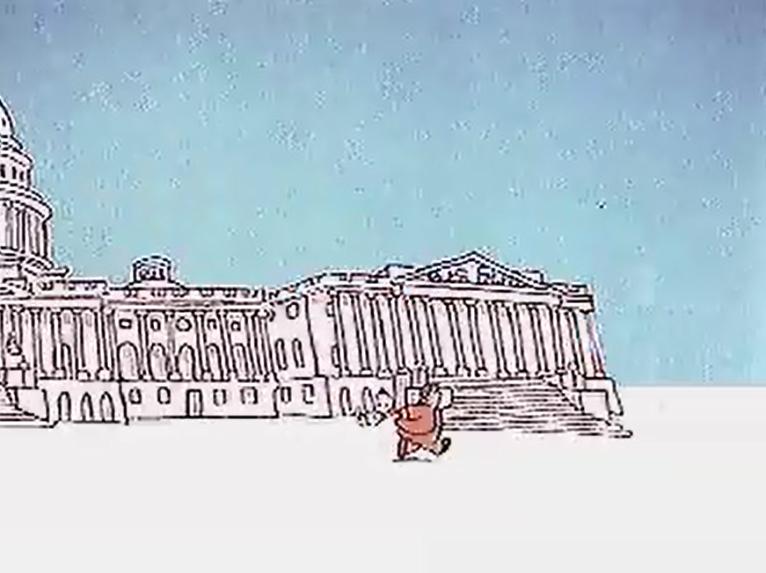
Bill is Debated & Voted on in House #2

Slide 18

Bill
Introduced in
House #1
Sent to Committee
in House #1
Debated & Voted on
in House #1
proposed
Bill
Debated & Voted on
in House #2
Sent to Committee
in House #2
Introduced in
House #2

Slide 19
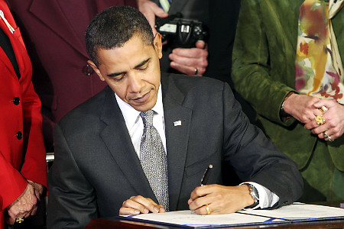
Bill is Signed or Vetoed by the President

Slide 20
Bill
Introduced in
House #1
Sent to Committee
in House #1
Debated & Voted on
in House #1
proposed
Bill
Debated & Voted on
in House #2
Sent to Committee
in House #2
Introduced in
House #2
President
Signs or Vetoes

Slide 21


Slide 22
Bill is…

Slide 23
1. Bill is proposed
Bill is…
Proposed

Slide 24

2. Bill is introduced
Bill is…
Proposed
Introduced

Slide 25
3. Bill is sent to a committee
Bill is…
Proposed
Introduced
Sent to Committee

Slide 26
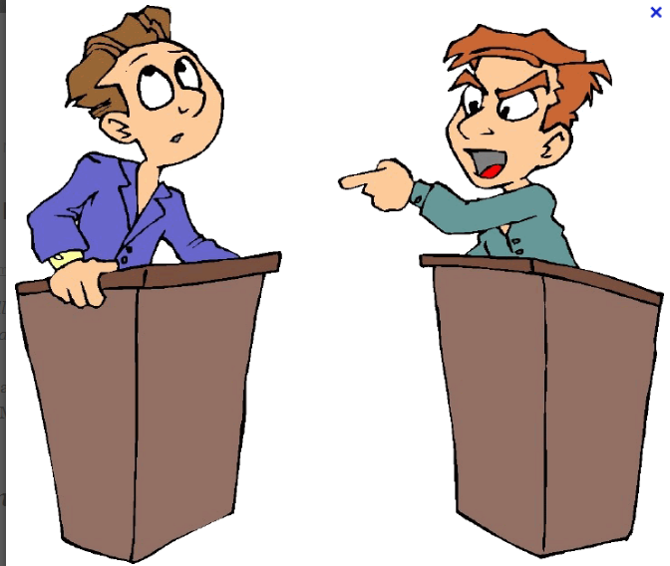
4. Bill is
Debated and Voted on
Bill is…
Proposed
Introduced
Sent to Committee
Debated & Voted

Slide 27
5. Bill is
Signed or Vetoed by President
Bill is…
Proposed
Introduced
Sent to Committee
Debated & Voted
President
Signs or Vetoes

