Slide 1

"Famous" Bill becomes a Law

Slide 2
Bill becomes a law
Make 5 Slides
The heading for each slide:
  a step in how a bill becomes a law
Each slide will have at least three pictures
  1 picture describing the step
  1 picture of a famous Bill (cannot use same Bill twice)
  1 picture of a famous place in the United States
    Insert a text box that labels the famous place
Tips:
when image searching, sometimes literal searches will not work.
  example: instead of searching for the word propose, search for a synonym.

Slide 3
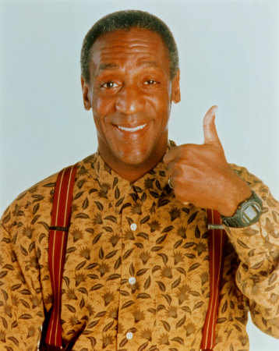
1. Bill is proposed

Slide 4


2. Bill is introduced

Slide 5

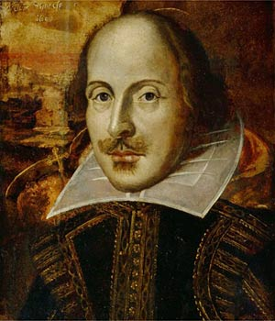
3. Bill is sent to a committee

Slide 6
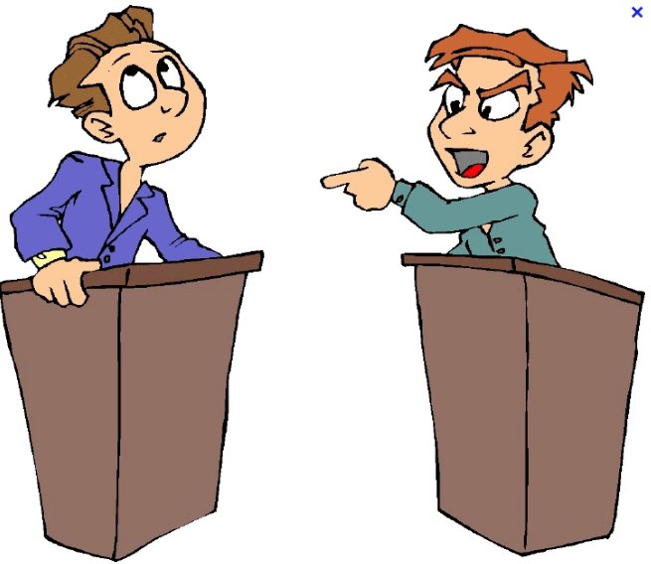

4. Bill is Debated and Voted on

Slide 7
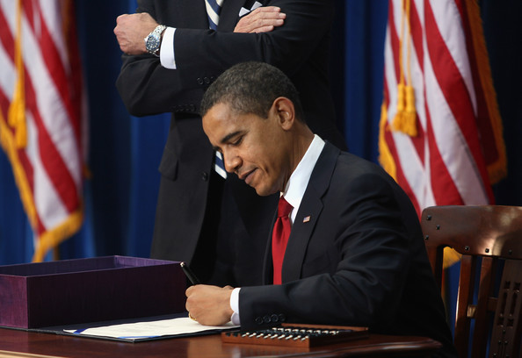

5. President Signs or Vetoes the Bill

