Slide 1
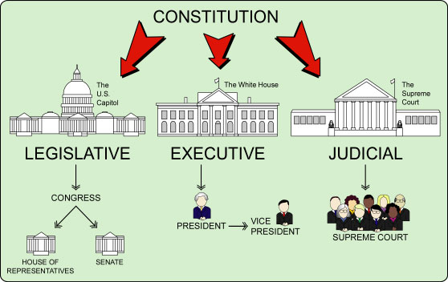
Checks and Balances (part 1)

Slide 2
Separation of Powers
legislative
executive
Judicial

Slide 3
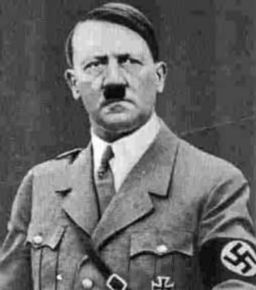
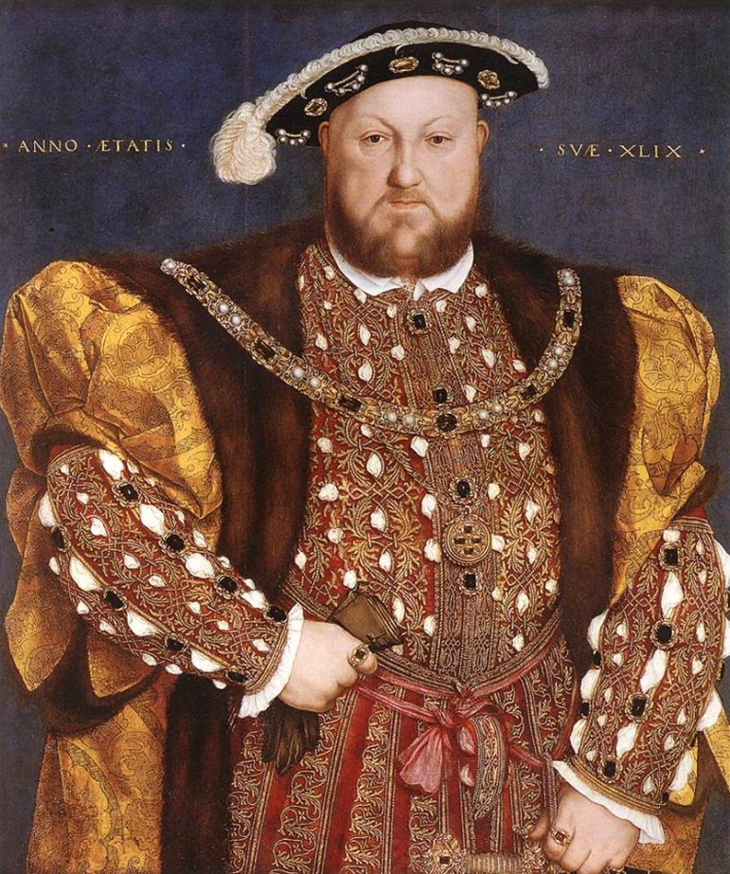
Separation of Powers

Slide 4
Checks and Balances: prevents one branch of government from becoming to powerful
Limited
Government

Slide 5
Checks and Balances: prevents one branch of government from becoming to powerful
check
check

Slide 6
Limited Gov’t = Checks and Balances
Make a Law:
“Congress gets a raise. Senators make $1 million per year”
VETO
the Law

Slide 7
Legislative
Baby
Executive
Break Dancer
veto

Slide 8
Limited Gov’t = Checks and Balances
Override
The VETO
Make a Law:
“Congress gets a raise. Senators make $1 million per year”
VETO
the Law

Slide 9
Legislative
Scorpion
overrides
veto
Executive
Old Man

Slide 10
Limited Gov’t = Checks and Balances
Propose a new budget where the U.S. will spend a billion dollars on food stamps
Disapprove budget

Slide 11
Legislative
Liu Kang
Disapproves
Budget
Executive
Old Man

