Slide 1
Campaign
Finance
Reform

Slide 2
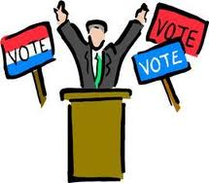
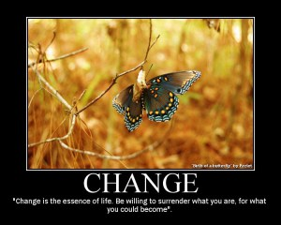
Campaign Finance Reform
Campaign
  Run for gov’t office
Finance
  Spending money
Reform
  Change

Slide 3

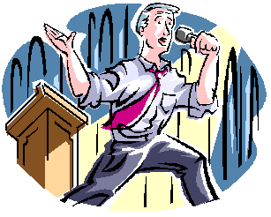
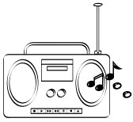
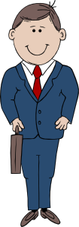

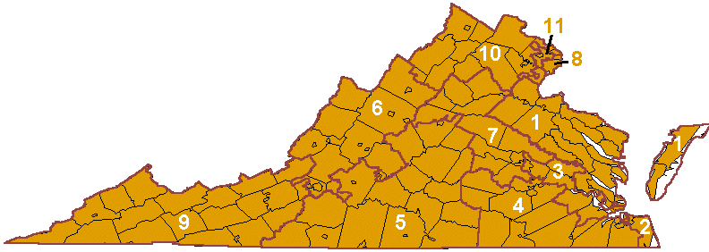
The way it is now
If we reform the system
best or richest?
who wins?

Slide 4
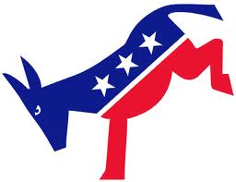
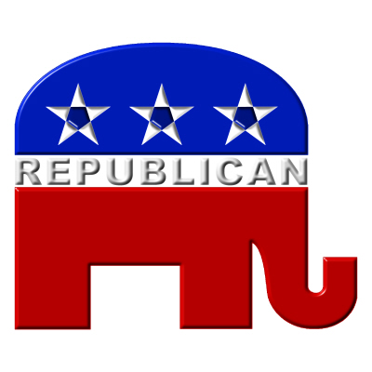
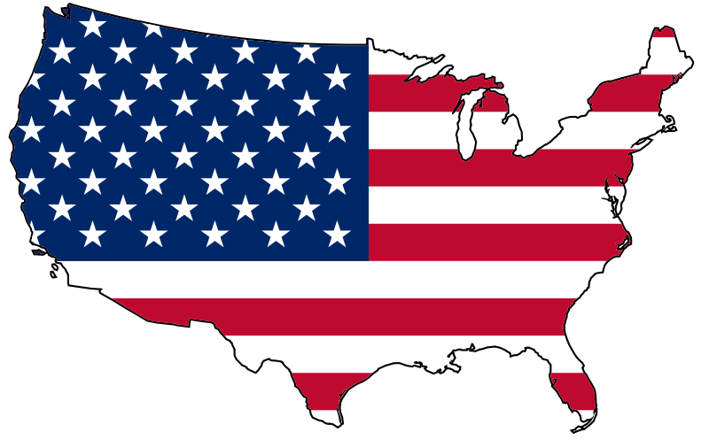
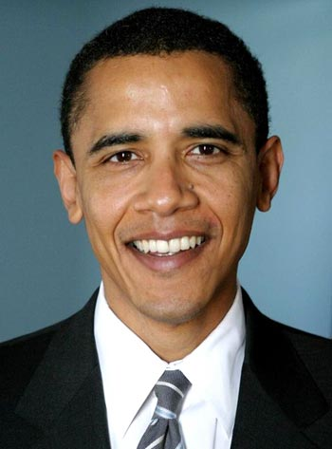
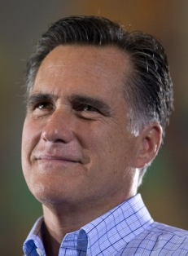

Slide 5

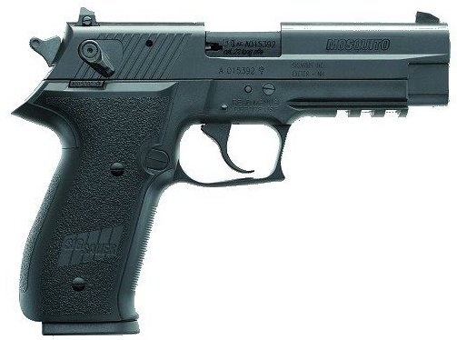
Interest Groups
NRA
  National rifle association
NEA
  National Educator Association

Slide 6


Lobbyists = employees of the interest group

Slide 7
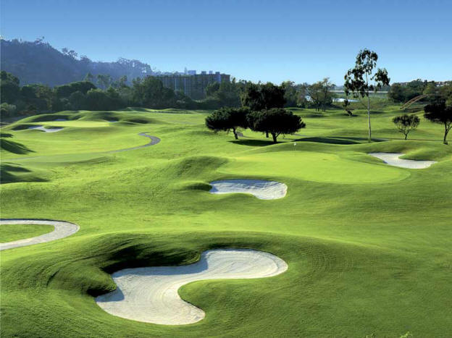
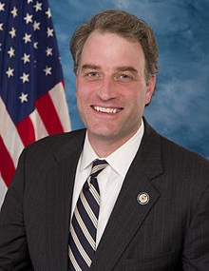
How about you do me a favor, and vote NO on the assault rifle ban.
Rob, how about we go golfing. I’ll pay.
Representative
Robert Hurt

Slide 8
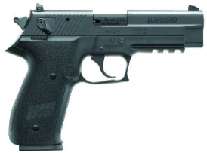
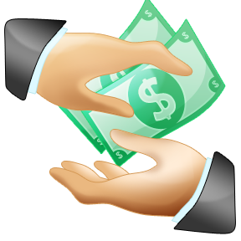
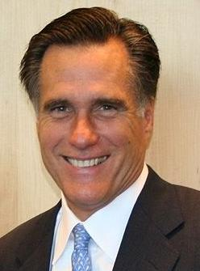
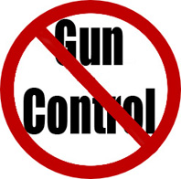
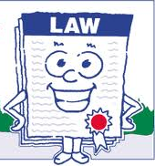
interest group
NRA
Mitt Romney
NO

Slide 9
interest group
NRA
What type of gun policy will he enforce?
Mitt Romney
Want Gun
Control

Slide 10
interest group
NRA

Slide 11
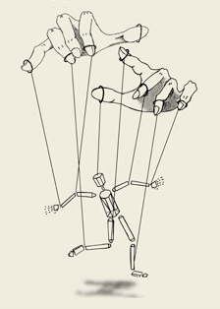
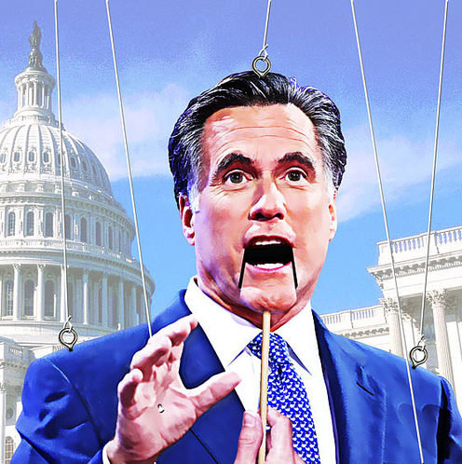
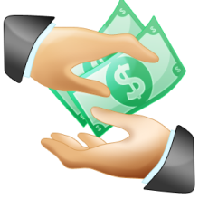
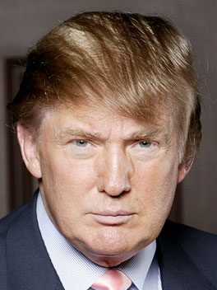

interest group
NRA
Mitt Romney
interest group
NRA
a lot more $$$
interest group
NRLC
PAC
Restore Our Future

Slide 12
Result
All about Money
Is Money more important than the People voting?

Slide 13
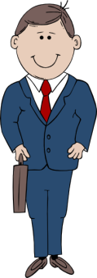
Campaign Costs are Rising
2008
$600,000
vs.
$800,000
Winner

Slide 14
Campaign Costs are Rising
Next
Election
2010
$1,000,000
vs.
$800,000
Winner

Slide 15
Campaign Costs are Rising
Next
Election
2012
$1,000,000
vs.
$1,500,000
Winner

Slide 16
Limit the amount of money spent!
Elect the best not the richest
interest group
NRA

Slide 17

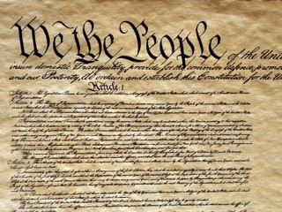
We can spend whatever we want! 1st amendment protects our freedom of speech!

Slide 18
Money is important to a candidate
What do you think a congressman does more:
Raise Money for his campaign
Make Laws

Slide 19
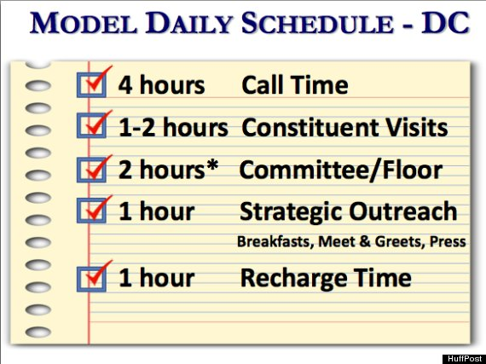
What if they can’t raise enough money. Where do they turn?
Interest groups & Lobbyists

