Slide 1
Career planning
Self-Assessment
Test:
Skills, Talents, and what you enjoy
Don’t forget…
How does technology affect jobs?
Creates New, take some away

Slide 2
Scarcity:
Consumption:
Production:
Resources:
Opportunity Cost:
Supply:
Demand:
Incentive:
Consumer Sovereignty:
Goods are limited
using goods
combining resources to make goods
factors of production
-human, capital, natural, entrepreneurship
What is given up when you choose
amount of goods made by PRODUCERS
amount of goods demanded by CONSUMERS
-Determines Price
anything that changes economic behavior
Consumer power

Slide 3
Too Much.
Gotta get rid of it!
Scarcity.
People love it.
Make as much $$$ as you can.
People hate it.
Lower the price to get people to buy

Slide 4
General Motors
Profit
Sales
Money made selling cars
Expenses
Buy parts to put the car together
Buy TV ads
Pay Employees

Slide 5
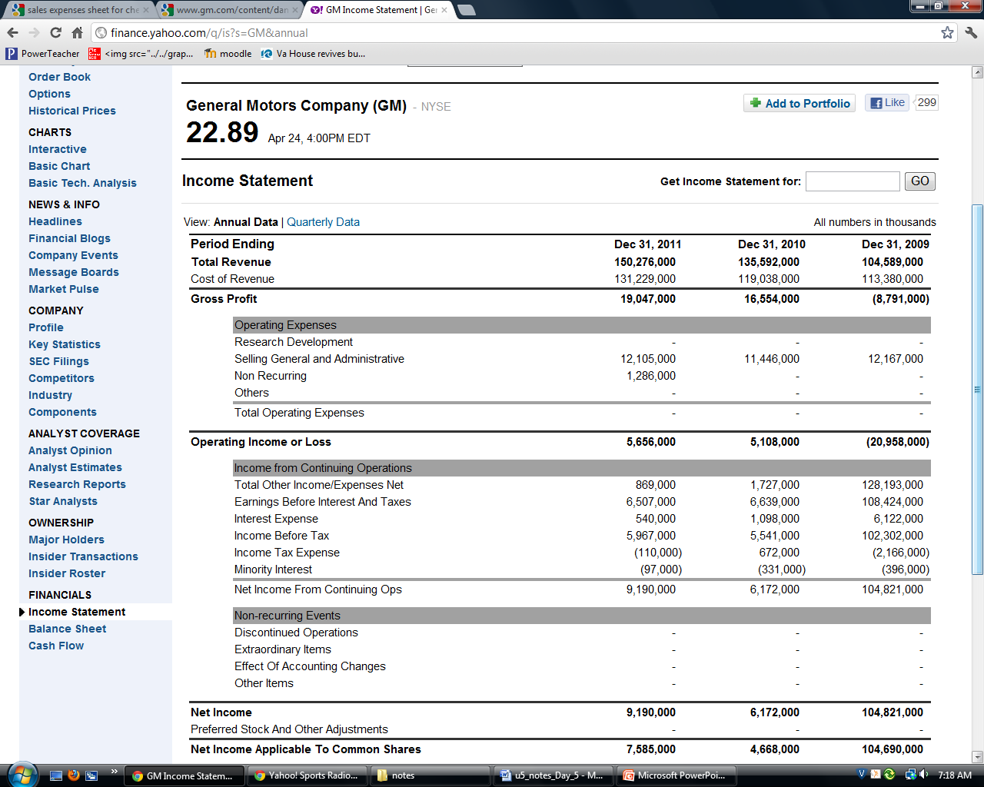

Slide 6
SALES
EXPENSES
PROFIT

Slide 7
Types of Economies
Traditional:
Family & customs
Command:
A lot of Gov’t involvement
Mixed:
Some gov’t
Free:
Very little Gov’t

Slide 8
Economies
Command
Free Market
Lot of gov’t
No choice
$$$ = gov’t
Gov’t Sovereignty
No competition
Few gov’t
choice
Profit Driven
Consumer Sovereignty
Competition

Slide 9
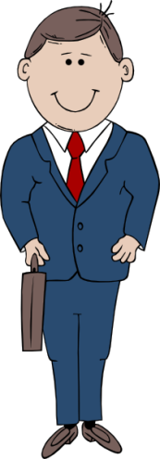
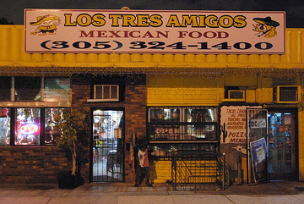
Types of Businesses
Proprietorship:
1 owner
Partnership:
2 or more
Corporation:
Many owners
Gambling on a business
Risk = investment
Acts as a legal person

Slide 10
Banks
Private
Financial
Institutions
$1000
$1000
6%
3%
borrower
bank
depositor
$1060
$1030
interest
$30

Slide 11
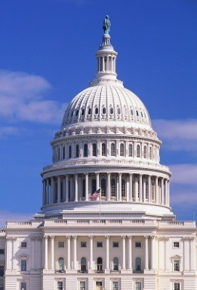
Economic Flow
Products
Consumer expenditure
Households
Firms
Wages, rent, dividends
Taxes
Resources
Taxes

Slide 12
Gov’t Involvement
Competition
Anti-trust laws (monopolies are illegal)
Global trade
Help new businesses
Protect consumers
Your property
Courts
Agencies to protect consumers (EPA, FCC, FTC)

Slide 13
The Fed
interest
rates
borrowing
spending
economy
interest
rates
stops inflation
borrowing
spending
economy
Bank’s
Reserve
borrowing
spending
economy
Bank’s
Reserve
stops inflation
borrowing
spending
economy

Slide 15
$$$
free
Exclusive
Non-Exclusive
Shoes
Fishing grounds
rivalrous
Cheeseburger
Pasture
Few Benefit
Cars
Wild-life
Movie Theater
Schools
Amusement Park
Roads
Public
Goods
Non-Rivalrous
Many benefit
Golf Course
Military

Slide 16
Schools
Roads
Military
Police
Firefighters
Fireworks
Radio
Public parks
Taxes
Public Goods
Something that benefits many people at the same time,
and anyone can use it

