Slide 1
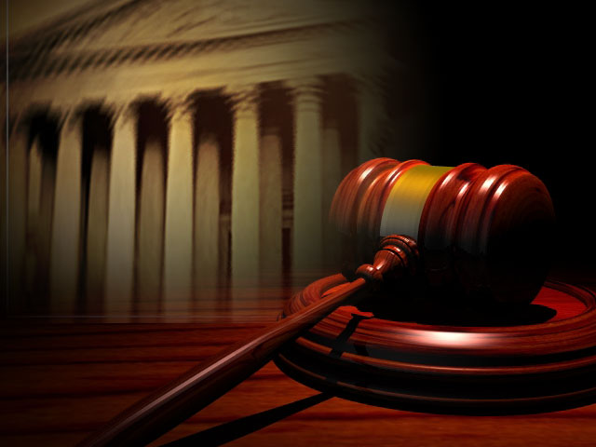
How Federal Courts Are Organized!
By- Lesly Martinez, Emileigh Berger,
and Elise Faverio

Slide 2
U.S District Courts!
District Courts are the federal courts where trials are
held and lawsuits are begun.
District Courts have which
means that they have authority to hear cases for the
first time.
Original jurisdiction
Every state has at least one district court, and
some have two, three, or four.

Slide 3
U.S Courts of Appeals!
Their job is to review decisions made in lower district courts.
^^This is referred to as appellate jurisdiction. ^^
There are 12 United States courts of appeals. Each one
covers a particular geographic area called a circuit.

Slide 4
Making a Decision!
Appeal courts do not hold trials.
They may decide an appeal in one of three ways: uphold the
original decision, or remand the case.
Remand means to send the case back to the lower court to be
tried again.

