Slide 1


Slide 2
Law Visuals

Slide 3

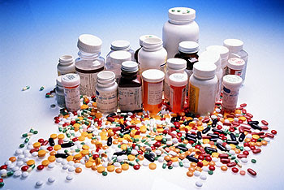
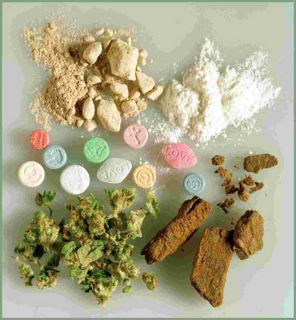


Criminal Law

Slide 4
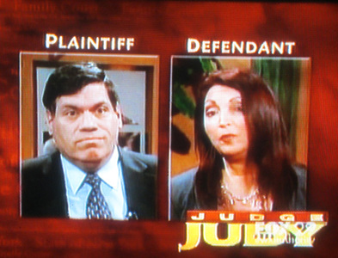
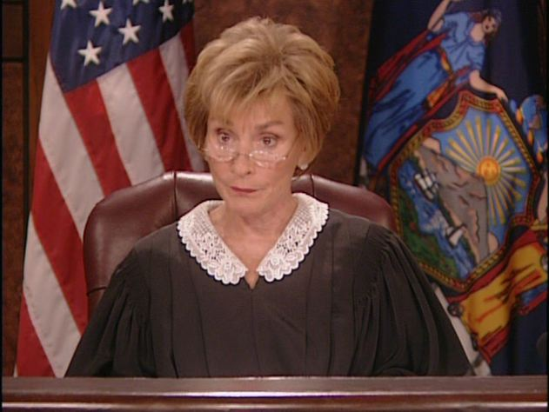
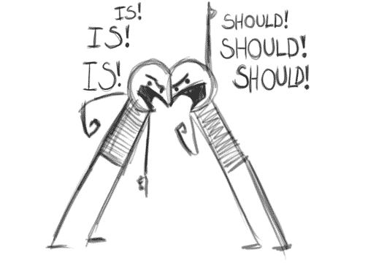
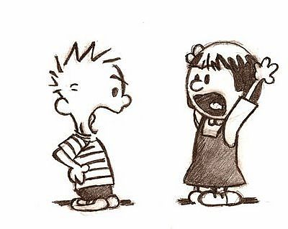

Civil Law

Slide 5

Felony

Slide 6
(1) Drug abuse violations
(2) Driving while Intoxicated
(3) Property crime (includes burglary, larceny, theft, motor vehicle theft, and arson.)
(4) Larceny-theft
(5) Assault
(6) Disorderly conduct
(7) Liquor laws
(8) Violent crime (including murder, non-negligent manslaughter, forcible rape, robbery, aggravated assault.
(9) Drunkenness
(10) Aggravated assault
(11) Burglary
(12) Vandalism
(13) Fraud
(14) Weapons violations (carrying or possession)
(15) Curfew and loitering
(16) Robbery
(17) Offenses against family and children
(18) Stolen property (buying, receiving, possession)
(19) Motor vehicle theft
(20) Forgery and counterfeiting

Slide 7
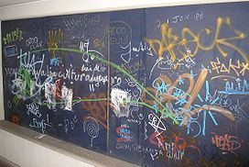
Misdemeanor

Slide 8
Aggravated harassment
Assault
Criminal contempt
Criminal mischief
Possession of certain illegal drugs
Possession of stolen property
Selling certain drugs
Trespassing
Endangering a child
Loitering
Graffiti
Resisting arrest

Slide 9
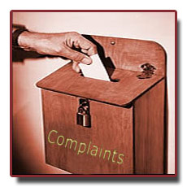
Civil Law Procedure
file complaint

Slide 10
Civil Law Procedure
trial
JURY

Slide 11
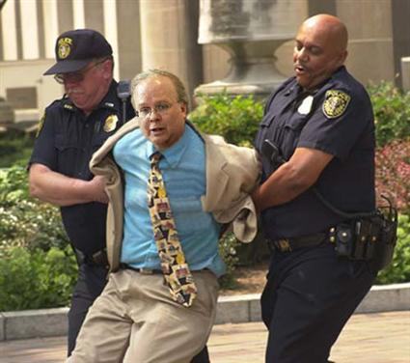
Criminal Law Procedure
arrest

Slide 12
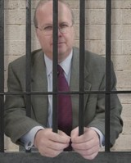
Criminal Law Procedure
Jail w/bail

Slide 13
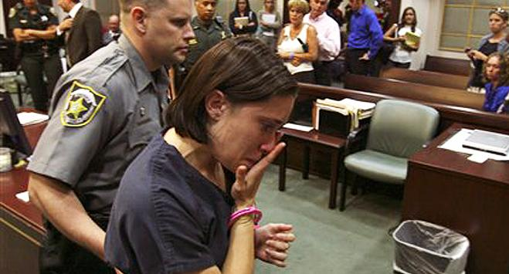
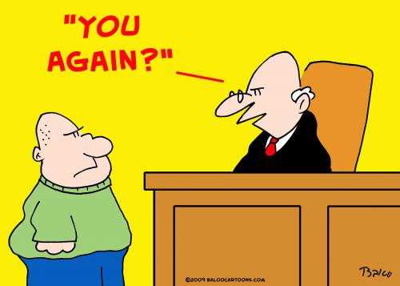
Criminal Law Procedure
Arraignment
-plea
Not Guilty.

Slide 14
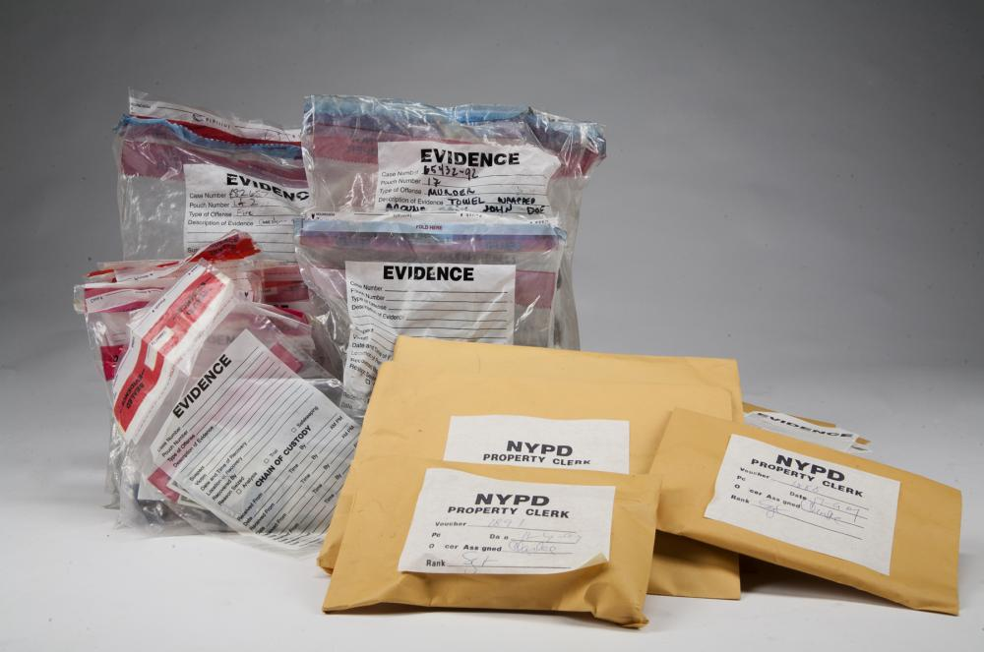
Criminal Law Procedure
Arraignment
-probable cause is reviewed

Slide 15
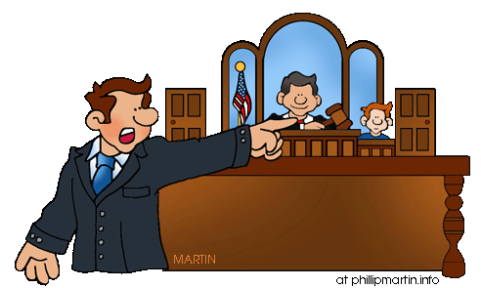
Criminal Law Procedure
Arraignment
-attorney if needed

Slide 16

Criminal Law Procedure
Arraignment
-trial date is set

Slide 17
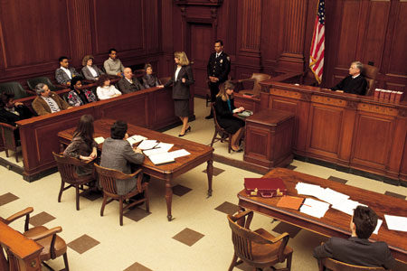
Criminal Law Procedure
Trial

Slide 18
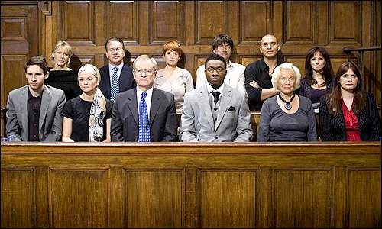
Criminal Law Procedure
Verdict
Guilty!

Slide 19
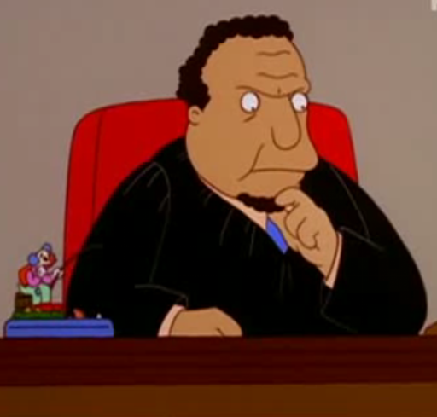
Criminal Law Procedure
Sentencing
200 hours of community service.

Slide 20
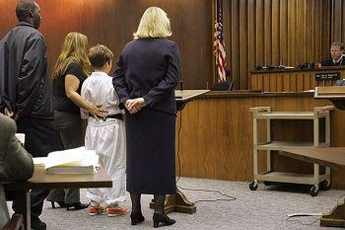
Juvenile Court Procedure

