Slide 1
Investing in a Corporation:
You invest in a business & hope it does well
If so, you make money
If not, you lose your investment
Just like:
Playing Fantasy Sports
You invest in players & hope they perform well
If so, you win.
If not, you lose.
What is the KEY to doing well?
Knowledge or research

Slide 2
How to Play: You have $100 to spend. The objective is to pick the drivers that you believe will do the best. You must spend your money wisely.
Scoring:
Finishing Position: 1st place gets 47 points, 2nd place gets 42, 3rd place gets 41, 4th place gets 40 points and so on in decrements of one point per position, with 43rd place earning 1 point.
Place Differential: Starting position minus finish position, +/- 1 point for each driver’s place differential. If a driver start 22nd and finished 12th. You get 10 points beside your driver moved up 10 spots (22-12=10). If your driver starts 5th and finishes 30th, then you lose 25 point because your driver lost 25 spots (5-30=-25).
Laps led: Ever lap your driver is in 1st place, you get ½ a point
Quality Passes: don’t worry about this. Basically, cars in the top 15 get a couple extra points.
Fastest Laps: don’t worry about this. Every race has about 200-500 laps. If your driver is the fastest car on a lap you get ½ a point. So if it’s 200 laps and your driver has the highest speed, you would get 100 pts.

Slide 3
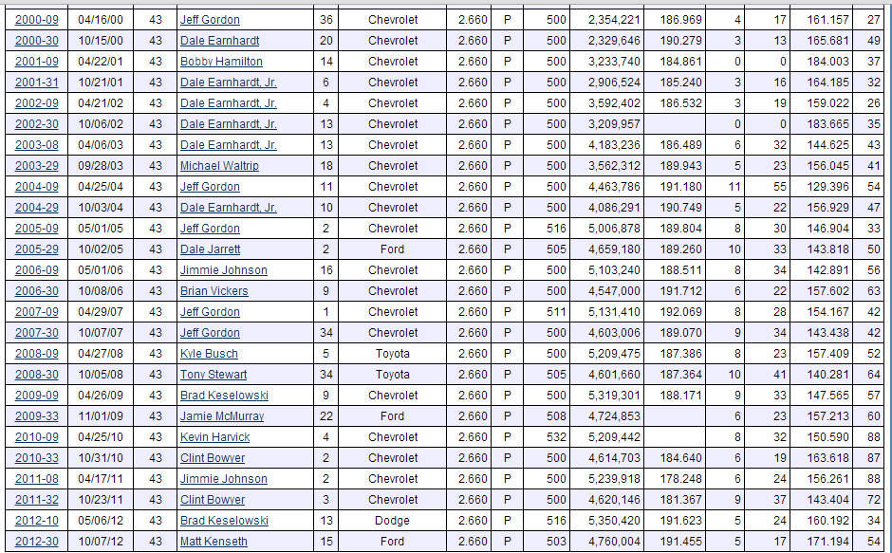
Research and Analysis

Slide 4
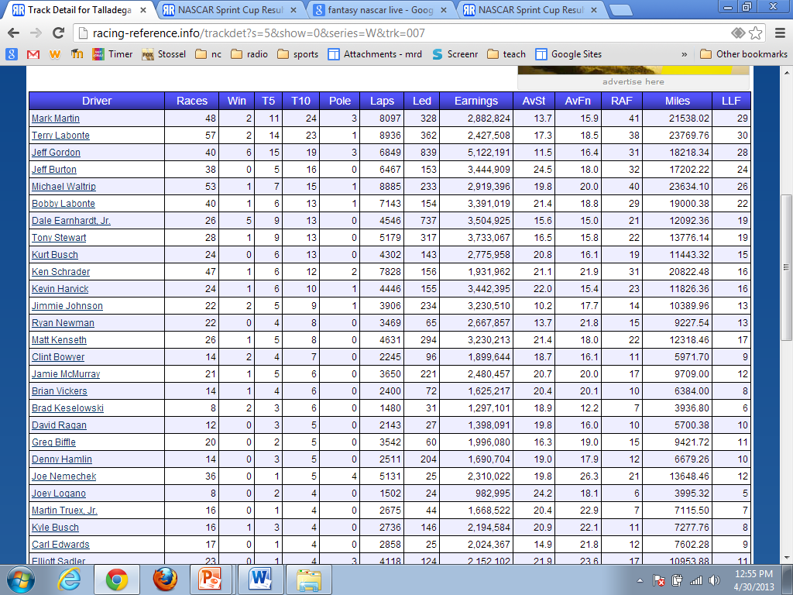
Research and Analysis

Slide 5
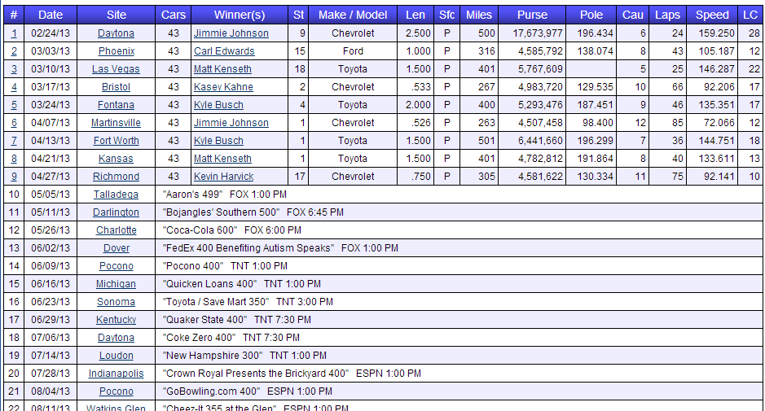
Research and Analysis

Slide 6
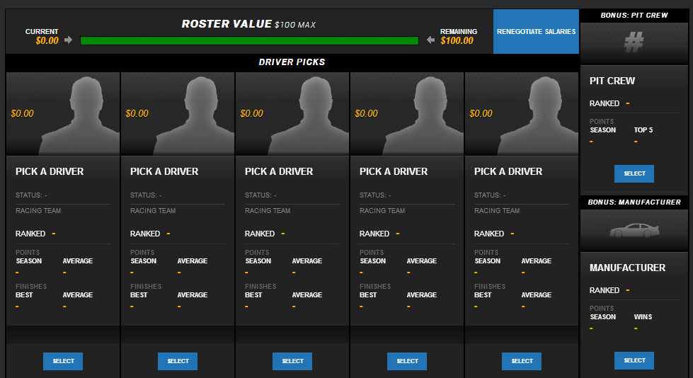
Picking your team

Slide 7
Picking your team

Slide 8
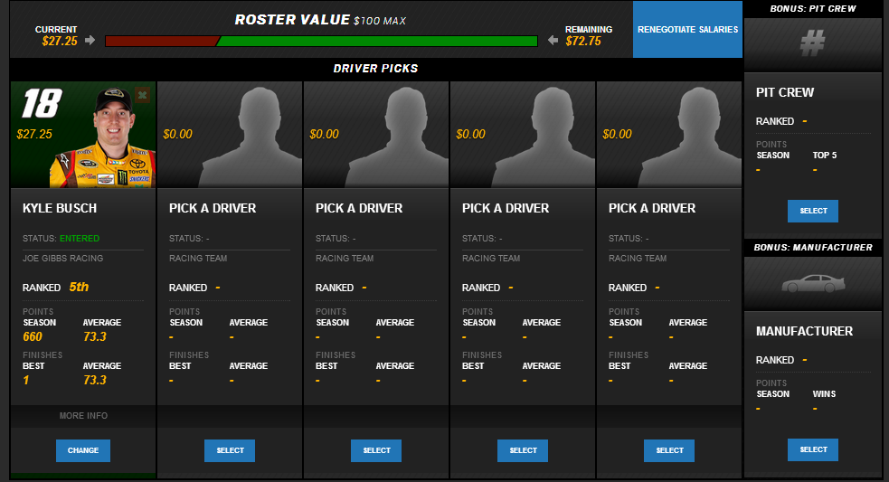
Picking your team

Slide 9
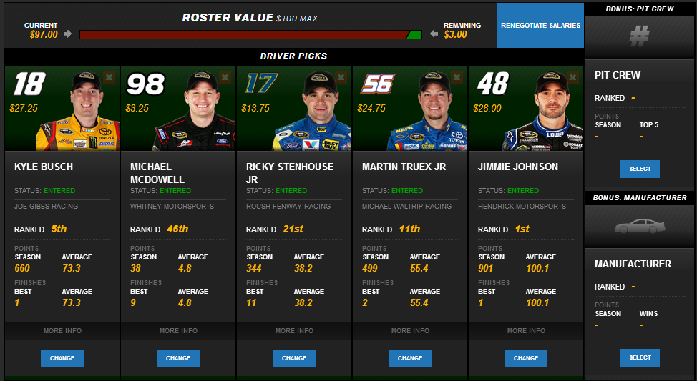
Picking your team

Slide 10
Picking your team

Slide 11
Research and Analysis

Slide 12
Research and Analysis

Slide 13
1st period
http://soa.li/UMxJ6mL
League name: MrD First Period Econ
Password: bfms
How to Play: You have $100 to spend. The objective is to pick the drivers that you believe will do the best. You must spend your money wisely.
Scoring:
Finishing Position: 1st place gets 47 points, 2nd place gets 42, 3rd place gets 41, 4th place gets 40 points and so on in decrements of one point per position, with 43rd place earning 1 point.
Place Differential: Starting position minus finish position, +/- 1 point for each driver’s place differential. If a driver start 22nd and finished 12th. You get 10 points beside your driver moved up 10 spots (22-12=10). If your driver starts 5th and finishes 30th, then you lose 25 point because your driver lost 25 spots (5-30=-25).
Laps led: Ever lap your driver is in 1st place, you get ½ a point
Quality Passes: don’t worry about this. Basically, cars in the top 15 get a couple extra points.
Fastest Laps: don’t worry about this. Every race has about 200-500 laps. If your driver is the fastest car on a lap you get ½ a point. So if it’s 200 laps and your driver has the highest speed, you would get 100 pts.
When doing research and analyzing driver data to make predictions, focus on:
Finishing Position is most important
Place differential is 2nd most important
Laps Led, quality passes, fastest lap are not that important.

Slide 14
2nd period
http://soa.li/eDYyRQI
League name: 2nd period Economics
Password: econ
How to Play: You have $100 to spend. The objective is to pick the drivers that you believe will do the best. You must spend your money wisely.
Scoring:
Finishing Position: 1st place gets 47 points, 2nd place gets 42, 3rd place gets 41, 4th place gets 40 points and so on in decrements of one point per position, with 43rd place earning 1 point.
Place Differential: Starting position minus finish position, +/- 1 point for each driver’s place differential. If a driver start 22nd and finished 12th. You get 10 points beside your driver moved up 10 spots (22-12=10). If your driver starts 5th and finishes 30th, then you lose 25 point because your driver lost 25 spots (5-30=-25).
Laps led: Ever lap your driver is in 1st place, you get ½ a point
Quality Passes: don’t worry about this. Basically, cars in the top 15 get a couple extra points.
Fastest Laps: don’t worry about this. Every race has about 200-500 laps. If your driver is the fastest car on a lap you get ½ a point. So if it’s 200 laps and your driver has the highest speed, you would get 100 pts.
When doing research and analyzing driver data to make predictions, focus on:
Finishing Position is most important
Place differential is 2nd most important
Laps Led, quality passes, fastest lap are not that important.

Slide 15
4th period
http://soa.li/SNWet3R
League name: 4th period Economics
Password: econ
How to Play: You have $100 to spend. The objective is to pick the drivers that you believe will do the best. You must spend your money wisely.
Scoring:
Finishing Position: 1st place gets 47 points, 2nd place gets 42, 3rd place gets 41, 4th place gets 40 points and so on in decrements of one point per position, with 43rd place earning 1 point.
Place Differential: Starting position minus finish position, +/- 1 point for each driver’s place differential. If a driver start 22nd and finished 12th. You get 10 points beside your driver moved up 10 spots (22-12=10). If your driver starts 5th and finishes 30th, then you lose 25 point because your driver lost 25 spots (5-30=-25).
Laps led: Ever lap your driver is in 1st place, you get ½ a point
Quality Passes: don’t worry about this. Basically, cars in the top 15 get a couple extra points.
Fastest Laps: don’t worry about this. Every race has about 200-500 laps. If your driver is the fastest car on a lap you get ½ a point. So if it’s 200 laps and your driver has the highest speed, you would get 100 pts.
When doing research and analyzing driver data to make predictions, focus on:
Finishing Position is most important
Place differential is 2nd most important
Laps Led, quality passes, fastest lap are not that important.

