Slide 1
Political Parties

Slide 2

Unit 2
History/creation
Of the US Gov‘t
Unit 3
US Gov‘t
Unit 4
Politics or
How to get into the gov’t

Slide 3


Who will win this fight?
vs.
Groups are stronger than an individual

Slide 4

We can accomplish more as a team

Slide 5

Do it all by yourself
or
Get help from a group

Slide 6


Democratic
Help republicans
Republican
Help democrats

Slide 8
Make Laws

Slide 9

Make
“Republican”
Laws
Make Laws

Slide 10
Enforce
“Republican”
Laws

Slide 11

Republican Law: Lower Taxes, but no more food stamps.

Slide 12
Make
“Democratic”
Laws
Make Laws

Slide 13
Enforce
“Democratic”
Laws

Slide 14
Democratic Law: Higher Taxes, but the poor get food stamps.

Slide 16
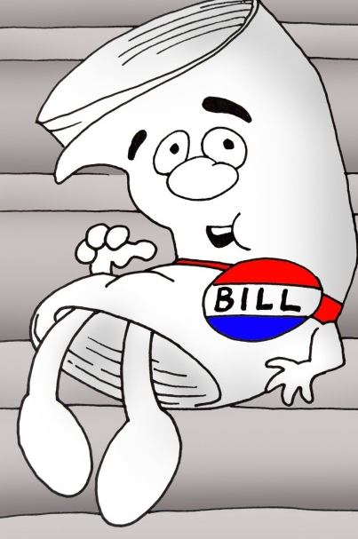
Democratic Laws
Republican Laws

Slide 17

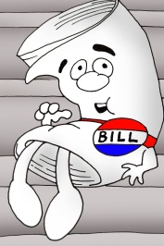

Slide 18

Getting Elected

Slide 19

Getting Elected

Slide 20

Getting Elected

Slide 21

Getting Elected

Slide 22
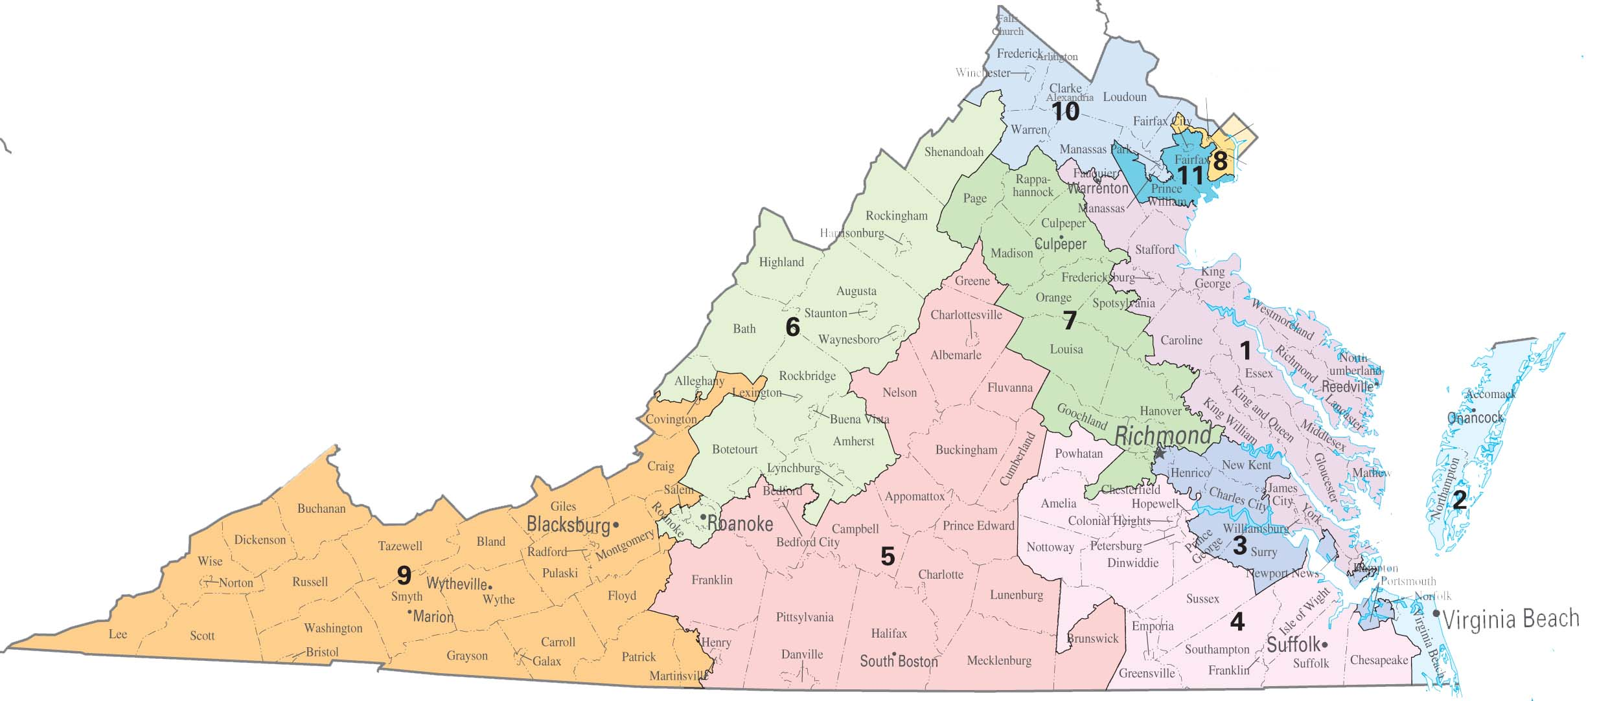

Getting Elected

Slide 23


Getting Elected
Steve
For
Congress

Slide 24
Getting Elected

Slide 25
Getting Elected

Slide 26

Getting Elected
Assistants

Slide 27
Getting Elected
Assistants

Slide 28
Where do candidates get the money?
?

Slide 29
Getting Elected

Slide 30


Slide 31

Nominating/Recruiting

Slide 32

Educate the Voters

Slide 33
Help the candidate win

Slide 34
After the Win

Slide 35



Monitor Office Holders

