Slide 1

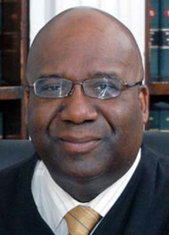
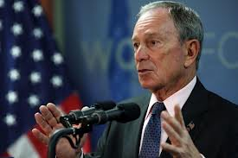


Checks and Balances in the news
Hold on. We have the power of Judicial Review. We want to review that law.
We will write that bill!
Soda is unhealthy. We need a law to ban large sugary drinks
This law is unconstitutional. It gives too much power to the executive branch. I remove this law.
bill
New York Mayor

Slide 2
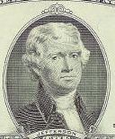
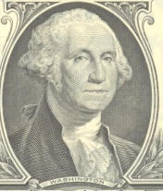
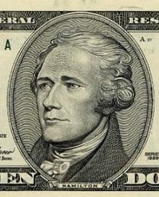
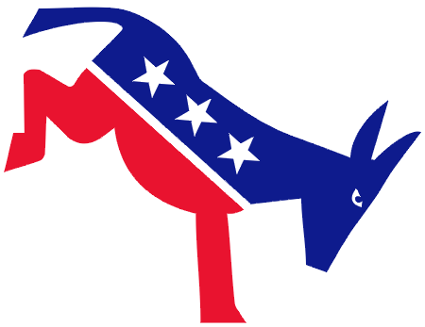
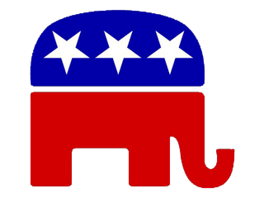
History of Political Parties
I completely disagree
with that. National
Government should have
the most power.
I want to become
president to assure that
the state governments
have power.
I Totally did
Not want this
to happen!
Oh Yeah! Well,
you have to get
elected first!
Bring it on!
Jefferson
Hamilton

Slide 3
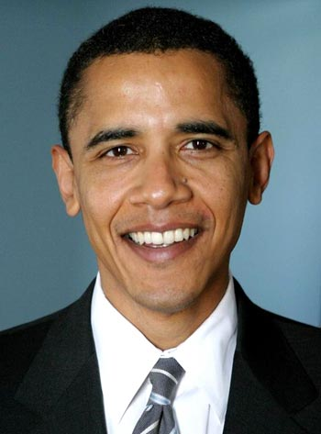
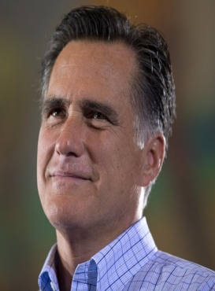
Democratic Party
mostly Liberal beliefs
Gov’t should help people (high taxes)
Gov’t should protect our rights
Republican Party
mostly Conservative beliefs
People should help themselves (low taxes)
Gov’t should enforce traditional beliefs

Slide 4

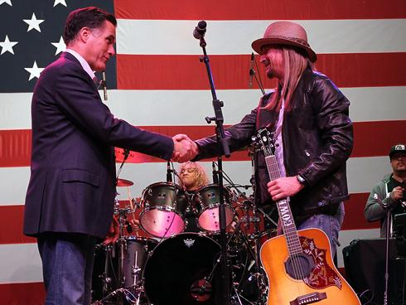
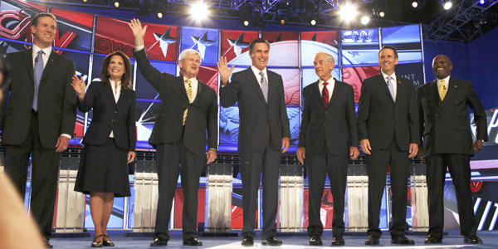
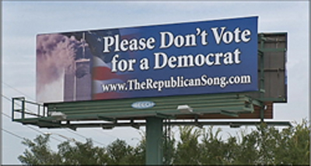
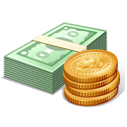
Functions of
Political Parties
Similarities of
Political Parties
Recruit/Nominate
Educate voters
Help candidate win
Monitor Office Holders

Slide 5
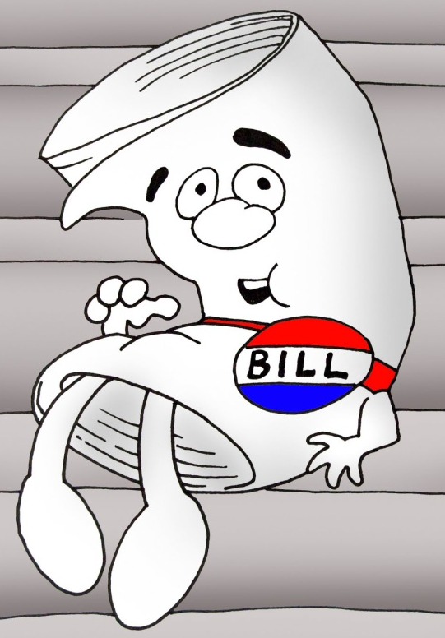

Functions of
Political Parties
Similarities of
Political Parties
Recruit/Nominate
organized to win
Educate voters
influence policy
Republican
Help candidate win
Monitor Office Holders

Slide 6
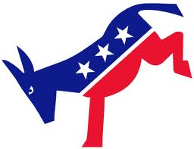

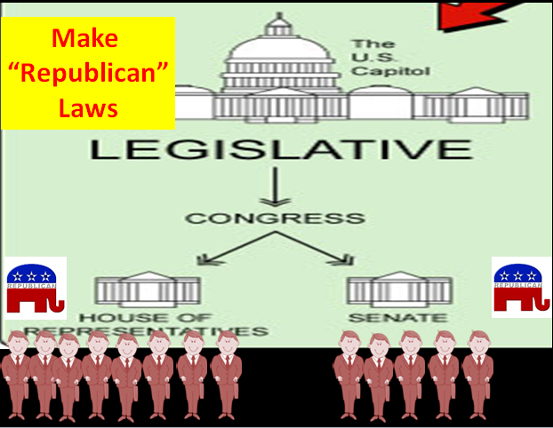
Influence policy…write the rules!
Influence policy…write the rules!

Slide 7
Functions of
Political Parties
Similarities of
Political Parties
Recruit/Nominate
organized to win
Educate voters
influence policy
Liberal
Help candidate win
Liberal and Conservative
Monitor Office Holders
Conservative

Slide 8
Liberal Views
Conservative Views
“open-minded”
“traditional”
Political Spectrum
Political Parties have both Liberal and conservative views
Higher Taxes, Gov’t help
Pro Choice
For Affirmative Action
Against Death Penalty
For Public Schools
For Stem Cell Research
Fix Global Warming
Gun Control
Lower Taxes, No Gov’t help
Pro Life
Against Affirmative Action
For Death Penalty
Vouchers and Private Schools
Against Stem Cell Research
Global Warming is not real
Gun Freedom

Slide 9
Functions of
Political Parties
Similarities of
Political Parties
Recruit/Nominate
organized to win
Educate voters
influence policy
Liberal
Help candidate win
Liberal and Conservative
Monitor Office Holders
appeal to the center
Conservative

Slide 10
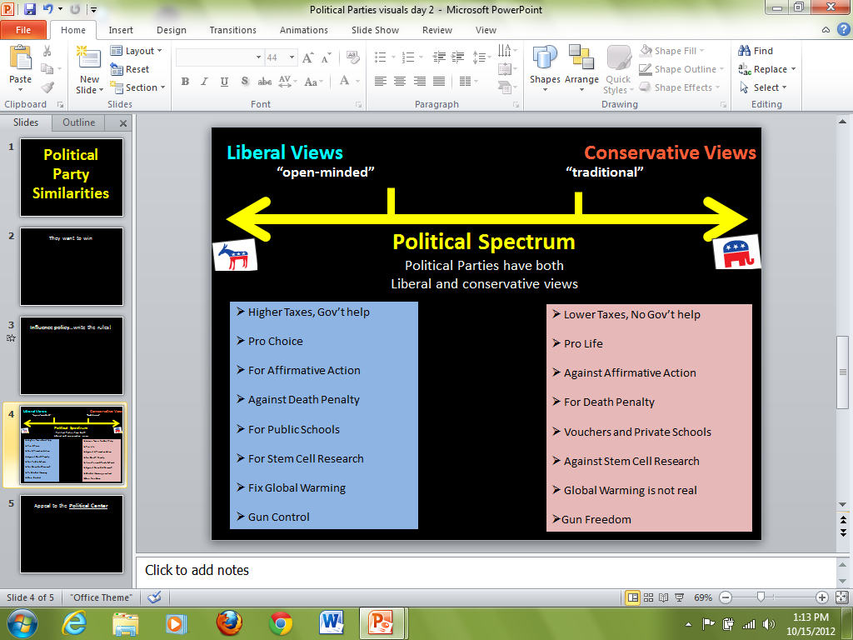

Appeal to the Political Center
Gun Freedom
Fix Global Warming

Slide 11
Difference of
Political Parties
Platform
List of Beliefs or Ideology
- Gov’t helps citizens
- Tax cuts for middle class
- End wars
- Pro-Choice
- Protect ALL citizens rights
- Gov’t shouldn’t help us
- Tax cuts for everyone
- Fight Terrorism
- Pro-Life
- illegalize same-sex marriage

Slide 12
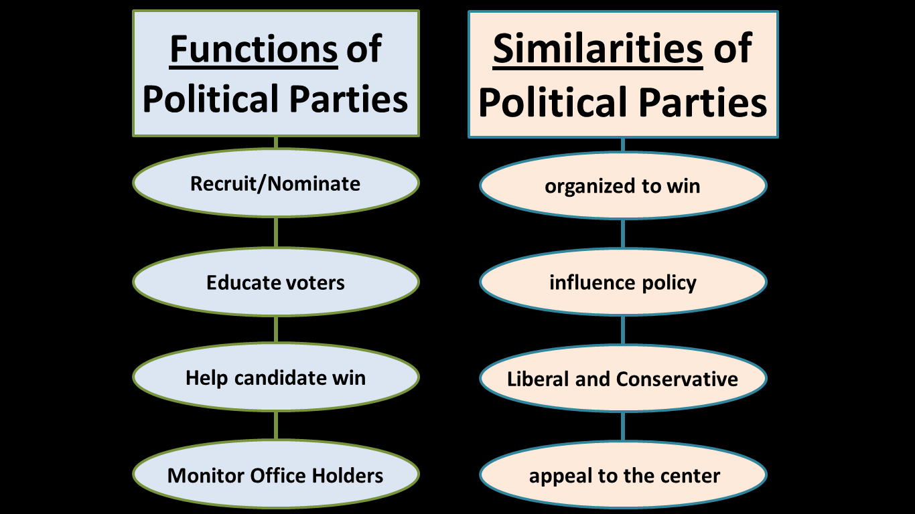
Costs
A lot of
$$$
$$$ from
interest groups
and PACs
Gov’t = $$$
Not Gov’t for
the people
Gov’t for
the people

Slide 13
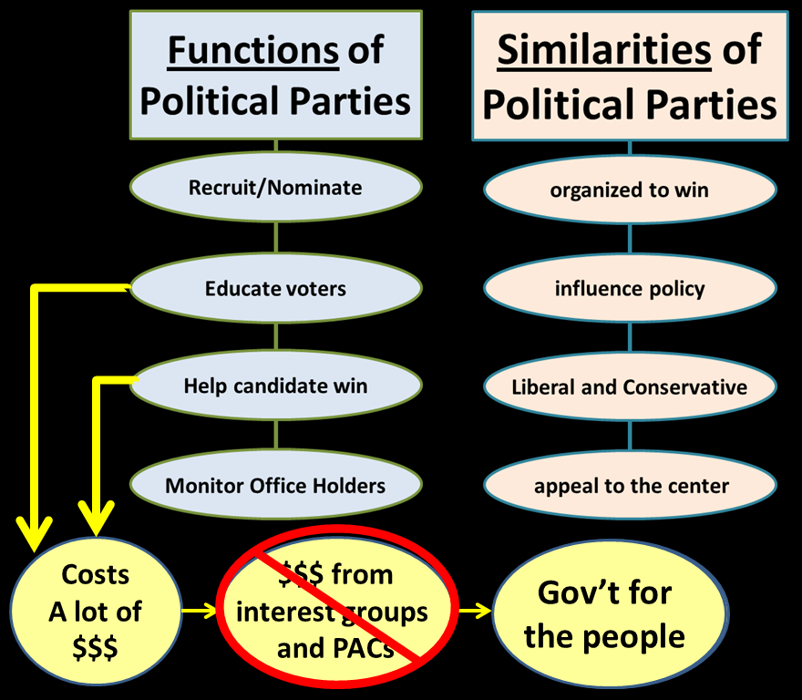
3rd
Parties
introduce
new ideas

Slide 14
Third Parties
Introduce New Ideas
  Green Party: Protecting the environment
  Progressive party: 8 hour working day
  Rent is too darn high party: Rent is to darn high
Sometimes influence the outcome of an election
Sometimes revolve around a personality
  Teddy Roosevelt and the Bull Moose Party

Slide 15
Voter
Registration

Slide 16
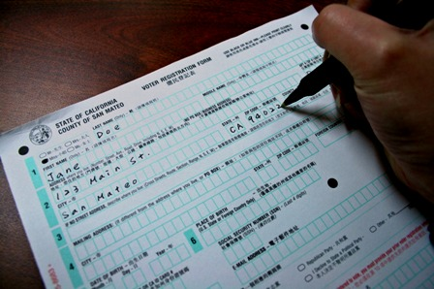
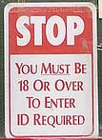
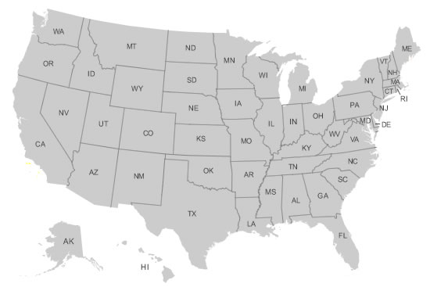
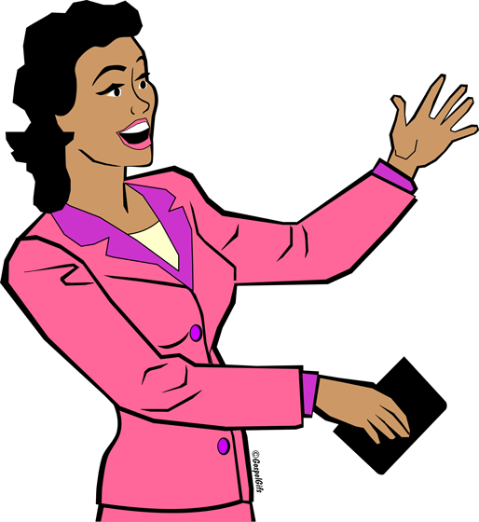
Voter Registration
Before you vote, you must register to vote
  Qualifications to vote:
    Citizen of U.S.
    Citizen of state you’re voting in
    18 years old by Election Day

Slide 17
Voter Registration
How to Register:
  sign up at:
    Registrar’s office
    DMV
    Library
    Gov’t office
    print online, and then Mail it
Must Register 22 days before an election

Slide 18
Voter Participation

Slide 19
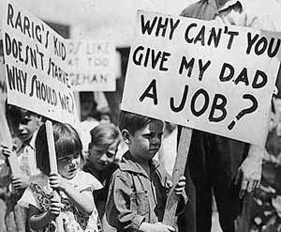
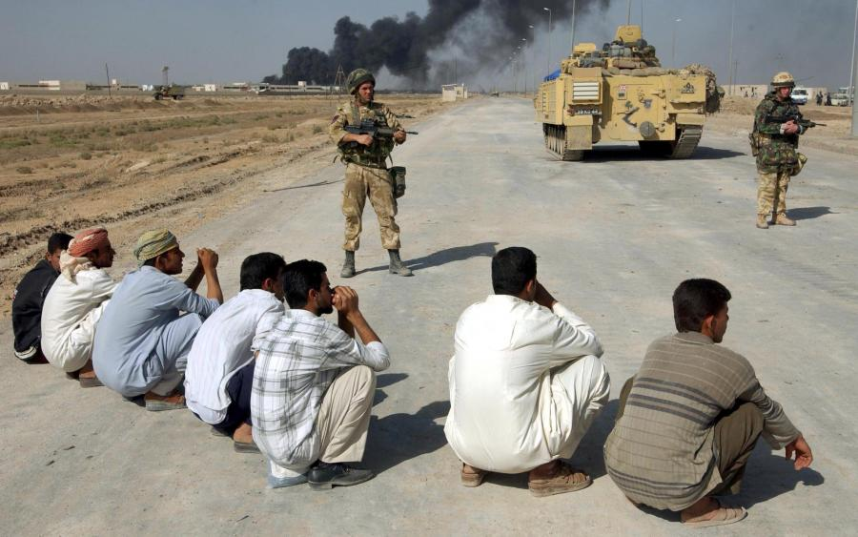
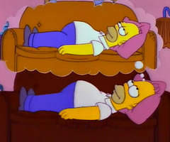
Highest Election Turnouts
When there are Big Issues in America
  Economy
  War
When the President is up for election
This is when the most people vote
  Small Issues
  Non-Presidential elections
    People do not vote, they sit at home
vs.

Slide 20
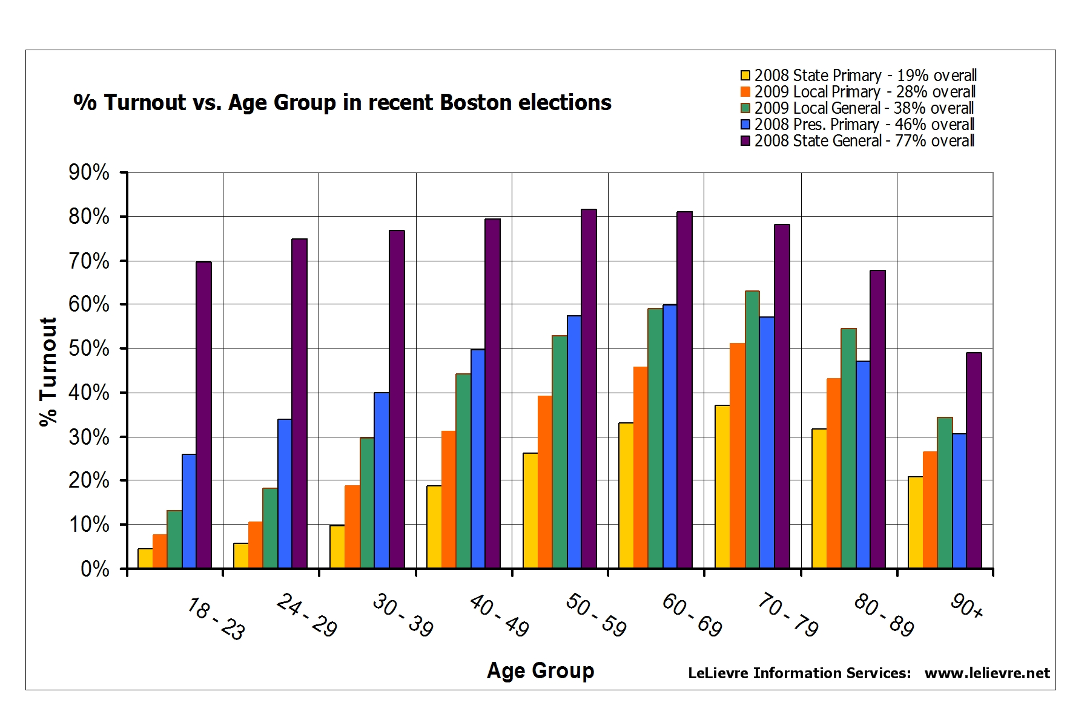
2008 = Presidential Election (purple)
2009 = Non-Presidential Election (green)

Slide 21
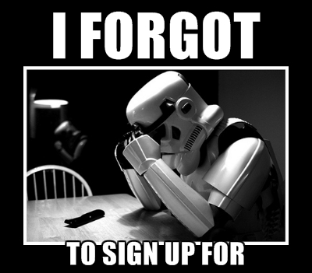
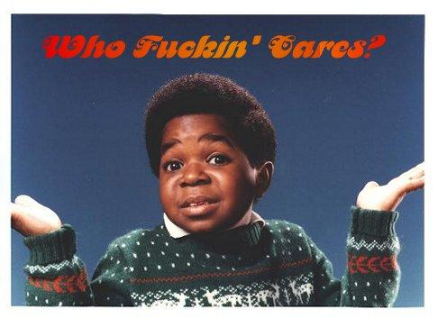
Why people do note to vote
Lack of interest
Failure to register
TO VOTE

Slide 22
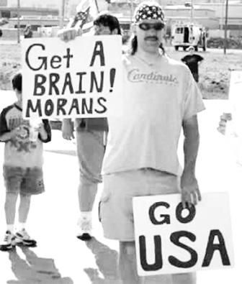
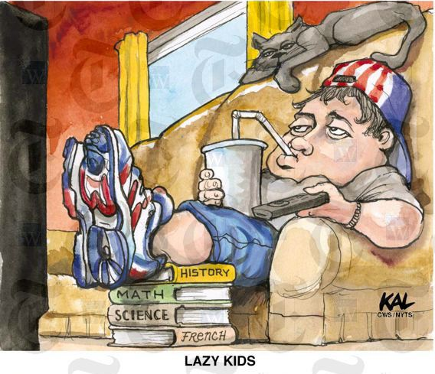
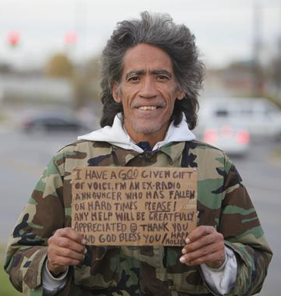
Who doesn’t vote
Age
  Young People
    Not interested
Education
  Uneducated
    Don’t understand the issues
Income
  Poor
    No time; other worries

Slide 24
Who?
Age
Young
Why?
Lack of Interest
&
Forget to Register
Education
uneducated
Income
Poor

Slide 25
Campaign
Finance
Reform

Slide 26

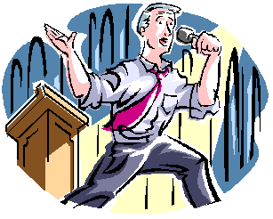

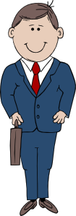
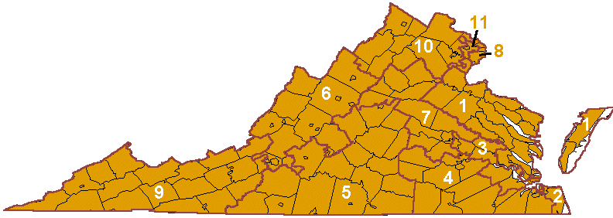

Slide 27
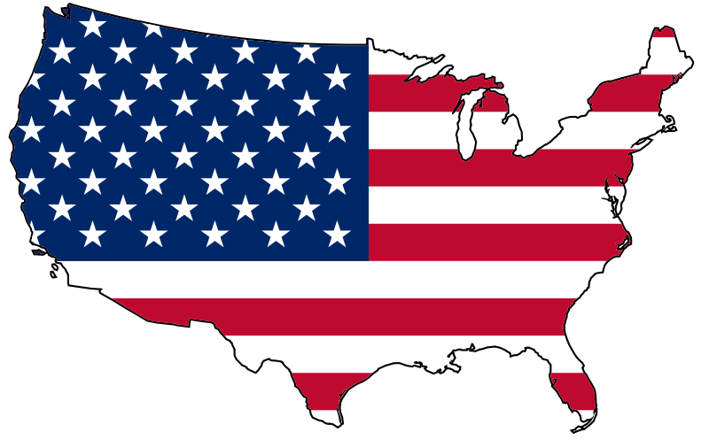


Slide 28


Interest Groups
NRA
  National rifle association
NEA
  National Educator Association

Slide 29
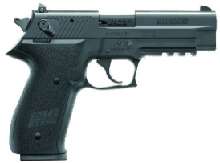
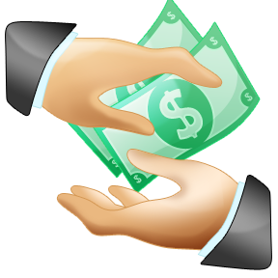
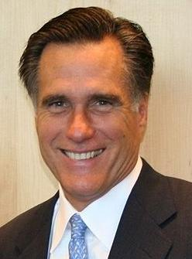

interest group
NRA
Mitt Romney

Slide 30
interest group
NRA
Mitt Romney
Want Gun
Control

Slide 31
interest group
NRA

Slide 32
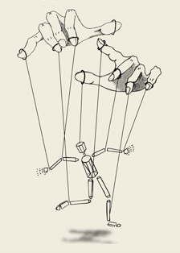
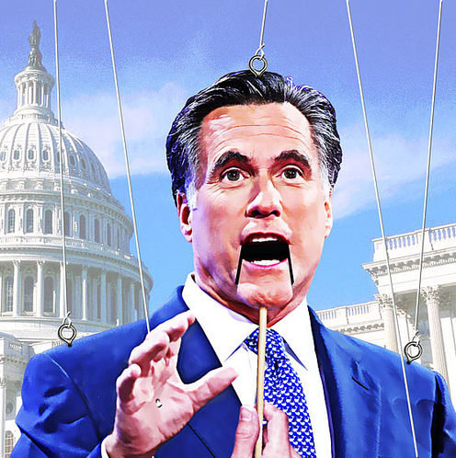

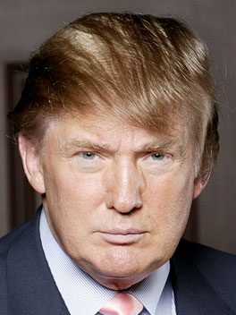

interest group
NRA
Mitt Romney
interest group
NRA
a lot more $$$
interest group
NRLC
PAC
Restore Our Future

Slide 33
Result
All about Money
Money is more important than fixing issues
Money is more important than the People?

Slide 34
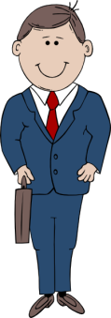
Campaign Costs are Rising
$600,000
vs.
$800,000
Winner

Slide 35
Campaign Costs are Rising
Next
Election
$1,000,000
vs.
$800,000
Winner

Slide 36
Campaign Costs are Rising
Next
Election
$1,000,000
vs.
$1,500,000
Winner

Slide 37
interest group
NRA

Slide 38
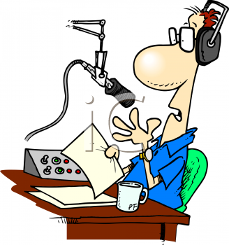
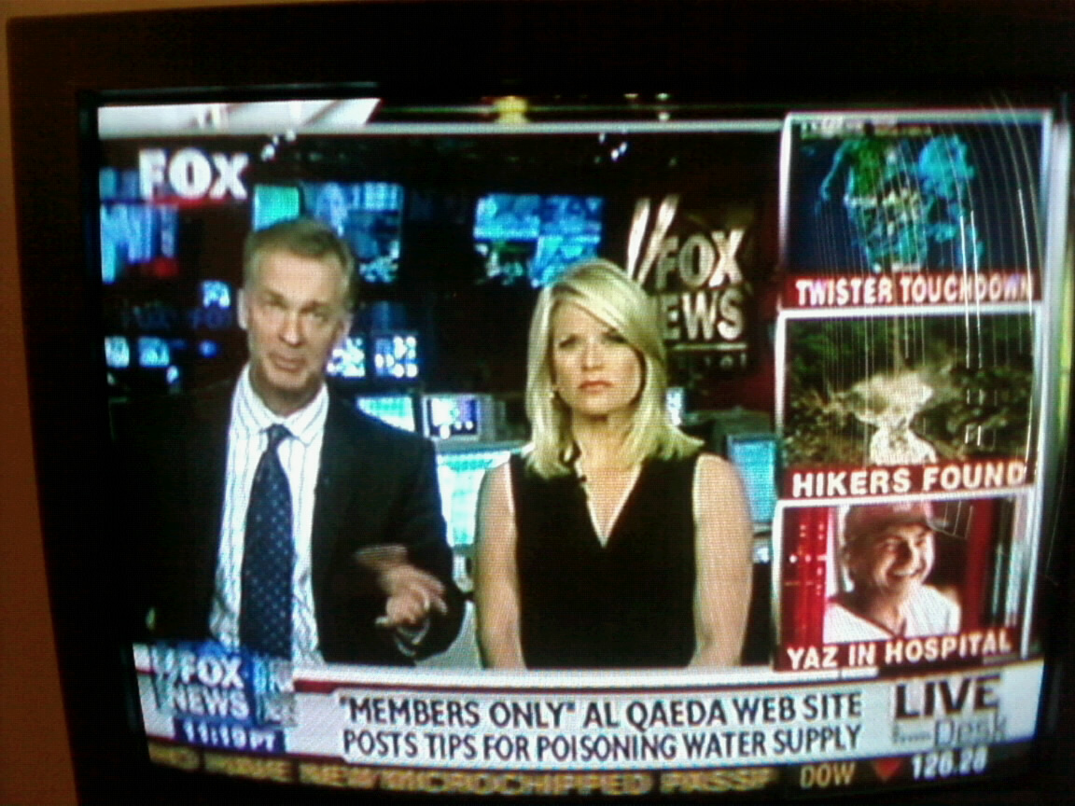
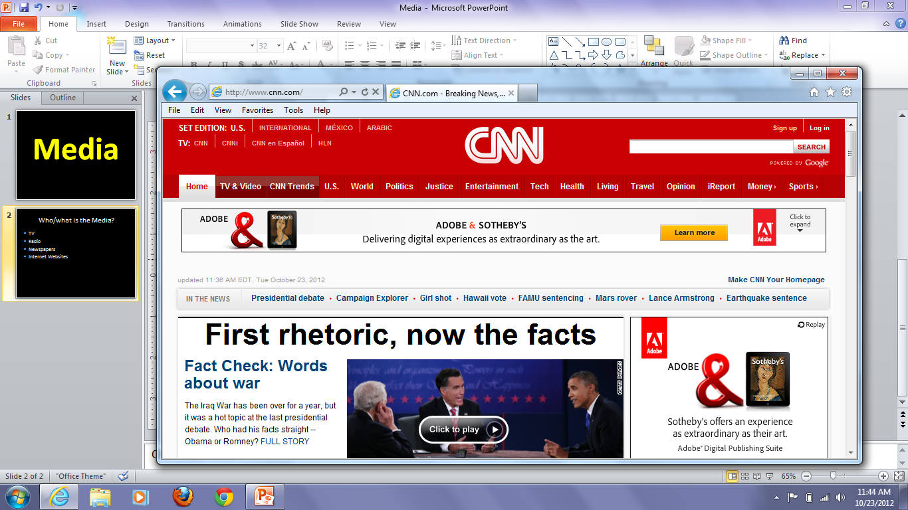
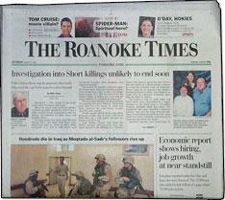

Who/what is the Media?
Who?
What?
Specific ways?
TV
Radio
Newspapers
Internet Websites

Slide 39
Media
Who?
What?
Specific ways?
Who?
TV
Radio
Newspaper
Websites
What
do they
Do?

Slide 40
Media
Who?
What?
Specific ways?
Who?
TV
Radio
Newspaper
Websites
What?
Keep citizens
informed

Slide 41
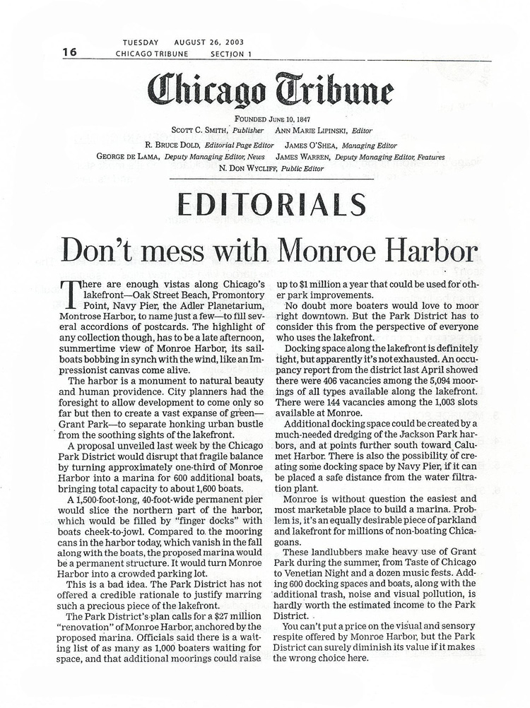
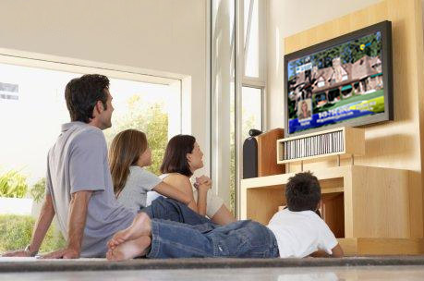
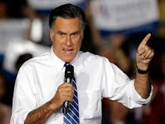


What does the media do?
Who?
What?
Specific ways?
Keep Citizens informed
  Identify Candidates
  Emphasize issues
  Write editorials
Why is it
Important to keep
citizens informed?
Citizens choose
the leaders of our
Government.
I am running for president!

Slide 42



What does the media do?
Who?
What?
Specific ways?
Keep Citizens informed
  Create Political Cartoons
  Publish op-ed pieces
  Broadcast different points of view

Slide 43






Media helps us understand campaigns
Separating fact from fiction
Detecting Bias
Evaluating Sources
Identify Propaganda
v
v
TV ad
against
Romney
False!!!
BIASED

Slide 44



Media and Public Policy
Public Policy: The Plan for our government
Media will focus on selected issues
Media will offer a forum
  Televised Debate
Media Holds Government accountable
  Call them out when they do wrong

