Slide 1
2 Days Left
Separation of Powers
Checks and Balances
Bill Becomes a Law

Slide 2
Separation of Powers
legislative
executive
Judicial

Slide 3
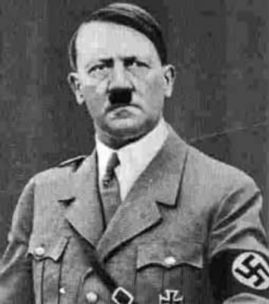
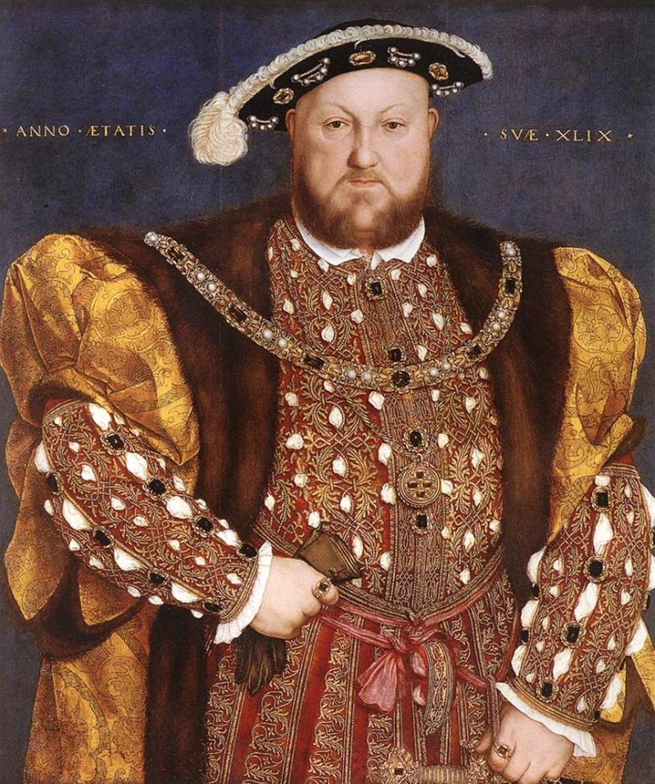
Separation of Powers

Slide 4
Checks and Balances: prevents one branch of government from becoming to powerful
Limited
Government

Slide 5
Limited Gov’t = Checks and Balances
Make a Law:
“Congress gets a raise. Senators make $1 million per year”
VETO
the Law

Slide 6
Legislative
Baby
Executive
Break Dancer
veto

Slide 7
Limited Gov’t = Checks and Balances
Override
The VETO
Make a Law:
“Congress gets a raise. Senators make $1 million per year”
VETO
the Law

Slide 8
Legislative
Scorpion
overrides
veto
Executive
Old Man

Slide 9
Limited Gov’t = Checks and Balances
Propose a new budget where the U.S. will spend a billion dollars on food stamps
Disapprove budget

Slide 10
Legislative
Liu Kang
Disapproves
Budget
Executive
Old Man

