Slide 1
Limited Gov’t = Checks and Balances
Make a Law:
“Congress gets a raise. Senators make $1 million per year”
Rule the law
is unconstitutional

Slide 2
Limited Gov’t = Checks and Balances
Propose a new budget where the U.S. will spend a billion dollars on food stamps
Rule actions
unconstitutional

Slide 3
Judicial – winning cat
Legislative
laws
Judicial
Review
Executive
actions

Slide 4
Limited Gov’t = Checks and Balances
Appoints
Judges
Rule actions
unconstitutional

Slide 5
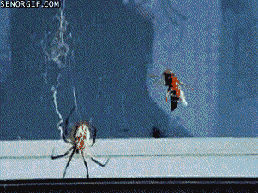
Executive
Spider
Appoints
judges
Judicial
bee

Slide 6
Limited Gov’t = Checks and Balances
Approves
Judges
Rule Laws
unconstitutional

Slide 7
Legislative
Penguin
Approves
judges
Judicial
Seal

Slide 8
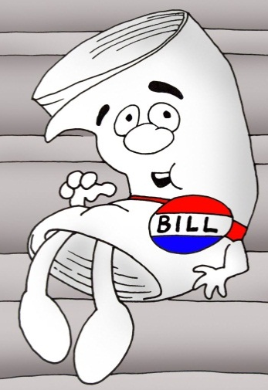
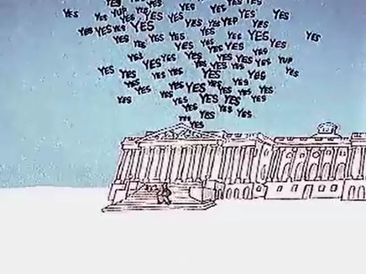
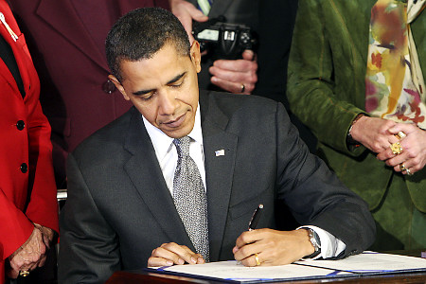
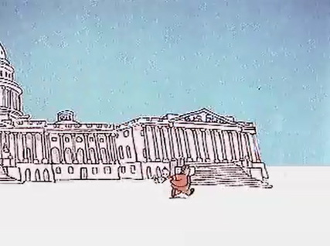
Bill
Introduced in
House #1
Sent to Committee
in House #1
Debated & Voted on
in House #1
proposed
Bill
Debated & Voted on
in House #2
Sent to Committee
in House #2
Introduced in
House #2
President
Signs or Vetoes
Bill Becomes a Law

Slide 9
435
100
Checks:
Override Veto
Approves Budget
Approves Appointments
Impeaches President & Judges
Checks:
Vetoes laws
Force Congress to work (special session)
Appoints judges
Checks:
Judicial Review
Declare laws unconstitutional
Declare actions unconstitutional

Slide 10
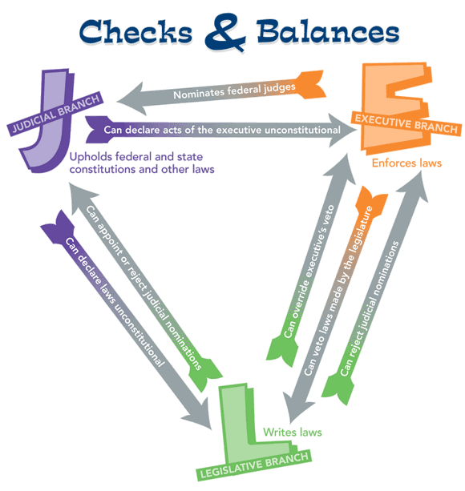
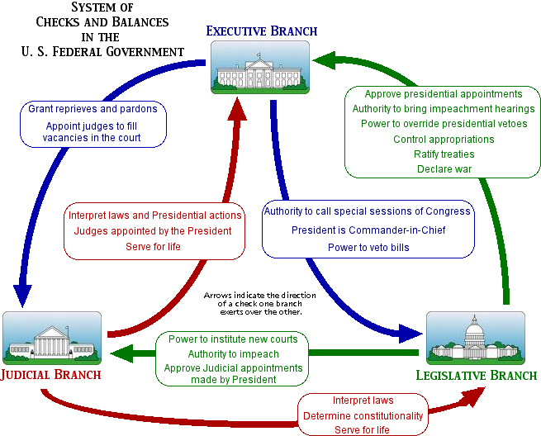
Google image search:
checks and balances

