Slide 1
Unit 1 – Citizenship
- 14th Amendment
- Civic Duties
- Civic Responsibilities
- Participate in Democracy
- 3 ways
Unit 2 – Creation of Gov’t
- Political Principles
- Significant Documents
- US Constitution
- Preamble
- Articles
- Bill of Rights
- 1st Amendment
- 5th amendment
Unit 3 – Nat’l Gov’t
- Legislative Branch
- Executive Branch
- Judicial Branch
- Marbury v. Madison
- Federal Courts
- Bill becomes a law
1
2
3
Unit 6 – Economics
- Terms
- Supply and Demand
- Types of Economies
- Businesses
- Banks
- Federal reserve
- Gov’t Involvement
- Globalization
- Tax, Borrow, Spend
- Public Goods
- Career Planning
- 16th amendment
Unit 5 – State & Local Gov’t
- Federalism
- 10th amendments
- 14th amendment
- State Courts
- Civil & Criminal Law
- Felony & Misdemeanor
- Legislative Branch
- Executive Branch
- Federal Gov’t Powers
- State Gov’t Powers
- Local Gov’t Powers
6
Unit 4 – Politics
- Job of Political Parties
- Similarities of Pol. Parties
- Platform & Ideology
- 3rd Parties
- Campaign Finance Reform
- How Media informs
- Media & Campaigns
- Registering to Vote
- Who doesn’t Vote & Why?
- Electoral College
5
4

Slide 2
Campaign financing
There are stacks of names in front of each lawmaker. They go through the list, making calls and asking people for money.
The fundraising never stops, because everyone needs money to run for re-election. In the House, the candidate with more money wins in 9 out of 10 races, according to the Center for Responsive Politics, a nonpartisan group that tracks money in politics. In the Senate, it's 8 out of 10.
It's not uncommon for congressmen to average three or four hours a day moonlighting as telemarketers. One lawmaker told me if it was the end of the quarter and he really needed to make his numbers, he'd be there all day long.
There's not always time to do both jobs. And often, the fundraising wins out over the lawmaking.

Slide 3
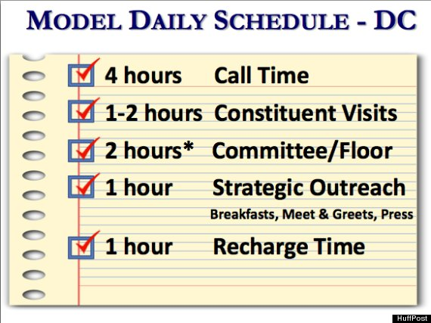
What if they can’t raise enough money. Where do they turn?
Interest groups & Lobbyists

Slide 4
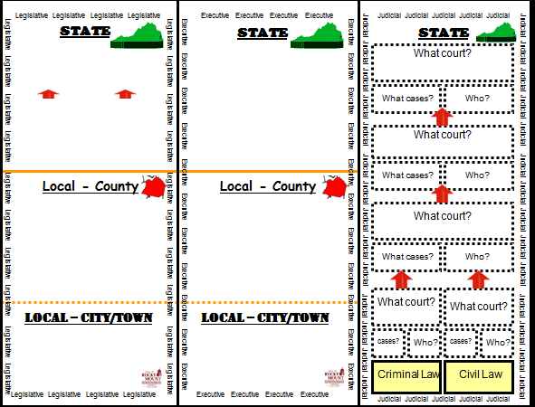

Slide 5
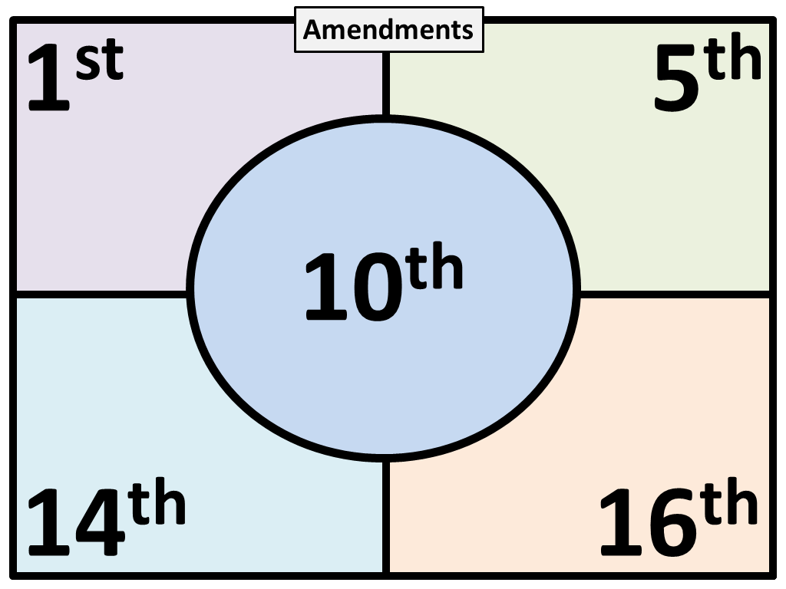

Slide 6
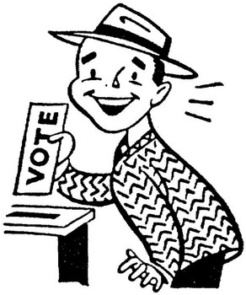


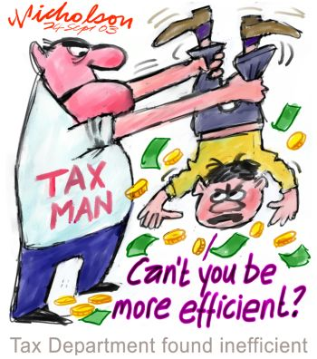
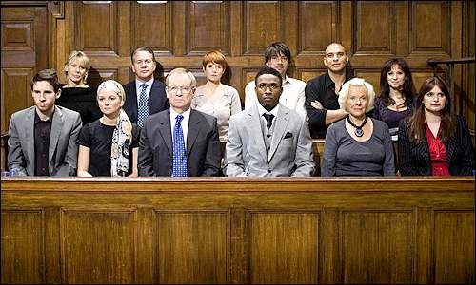
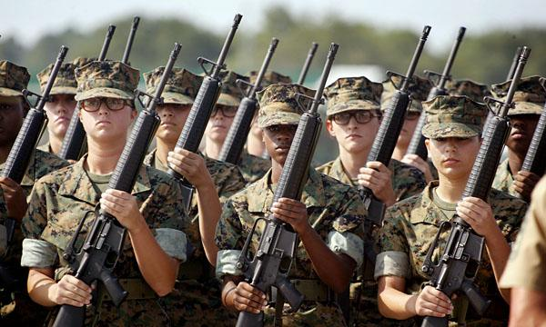
u1
citizenship
amendment
Duties ( )
Responsibilities ( )
Hold elective office
Communicate with gov't officials
Participate in Political Campaigns
Respect others rights to and an equal voice in the gov't
Respect different opinions

Slide 7
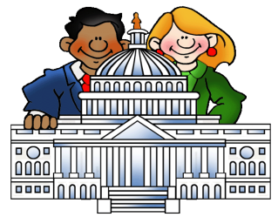


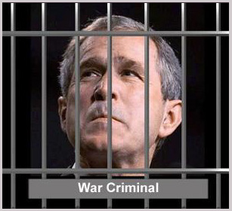
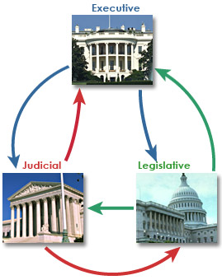


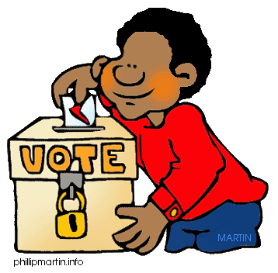
u2
F
P
P
Consent of the Governed
We pick people to vote for us
Democracy
Gov’t cannot do anything it wants
No one is above the law

Slide 8
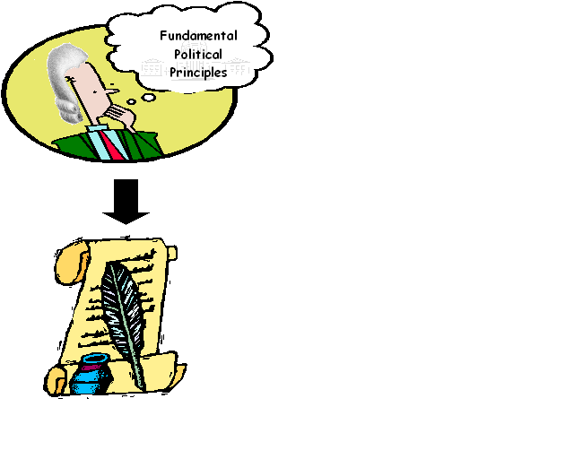
u2
Significant Documents
Charter of the Va. Company of London
Articles of
Confederation
-Rights of
Englishman
-
-Believe in
what you
want
-Life, liberty,
Property
-model for
-
-independence
-equality
-life, liberty,
-
-weak central
- states
-No: Prez, Taxes
Currency,
Enforce laws
-Life, liberty,
Property
-model for
Bill of Rights
& Dec of Indy
-grievances
-independence
-equality
-life, liberty,
Pursuit of
happiness

Slide 9
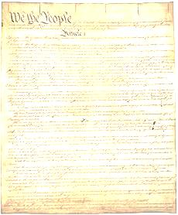
u2
US Constitution
Preamble
Articles
Powers of Gov’t
How to amend the constitution
Amendments
Changes
1-10:

