Slide 1
SOL Review Book
1

Slide 2
Table of Contents:
2
UNIT 1:Foundations of Government………..3-5
UNIT 2:Constitutional Government………...6-9
UNIT 3:The Legislative Branch (Congress)……....10-12
UNIT 4:The Executive Branch(President)………..13and14
UNIT 5:The Judicial Branch (Federal Courts)…….15-17
UNIT 6:People and Politics……………………18-22

Slide 3
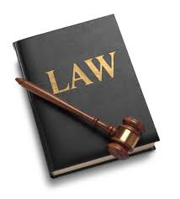
5 Principles of the U.S Government
3
People are the
source of power
Consent of the
governed
Limited government
Rule of Law
Democracy
Representative government
Government is
not all-powerful
The government and those
who are governed must follow laws
People rule
People elect public
office holders to
Make laws

Slide 4
Significant Documents
4
Virginia Statue for Religious Freedom
Charters of the Virginia
company of London
The Virginia Declaration of Rights
Declaration of Independence
Articles of Confederation
-Gov’t should protect Life, Liberty & Property
-Model for Bill of Rights &Dec of Independence
-People can form their own opinions
-1st Rep. gov”t
-Guaranteed rights of Englishmen
-Grievances
-Declared independence
-All men are equal
-Unalienable rights
-Very limited Gov’t
-Weak Central Gov’t
-1St national gov’t
-No prez

Slide 5
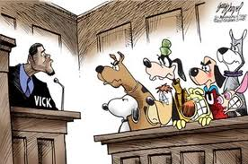
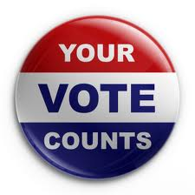
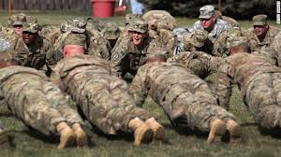
Birth
5
!4th Amendment
Naturalization
Citizenship
Civic Duties(Mandatory)
Responsibilities(voluntary)
Pictures
-Obey the law
-Pay Taxes
-Serve in Military
(if called)
-Serve in Jury
(if called)
-Not speeding
-Register to vote
-Hold elective vote
-Communicate
With gov’t officials
-Volunteer
-Participate in
Political campaigns

Slide 6
Checks and Balances, Separation of Powers and Federalism
6
Checks and balances: Each branch has the power to check the other braches and make sure they don’t have to much power. It also balances for equal power.
Separation of Power: Separate the government (power) into three branches
Federalism: Dividing power between national and state.

Slide 7
Six goals in the Preamble
7
Consent of the governed
We the People
To form a more perfect union Kill Articles of Confederation
Establish Justice Fair courts & laws
Domestic tranquility Peace in the USA
Common defense Protect from other countries
Promote the general welfare Make our lives better
Blessings of liberty Protect our rights

Slide 8
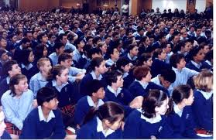
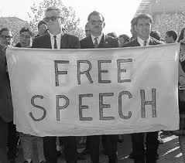
The First Amendment
8
R
1st Amendment
Freedom of:
Religion
Assembly
Press
Petition
Speech
A
P
P
S

Slide 9
Amending the Constitution
9
Two ways to amend the US constitution
National Congress Proposes
States vote
State demand Convention
Proposes
Amending the STATE Constitution
General Assembly Proposes
Voters
Covention Proposes

Slide 10
The Senate
10
Members=100

Slide 11
House of Representative
11
435 Members

Slide 12
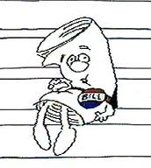
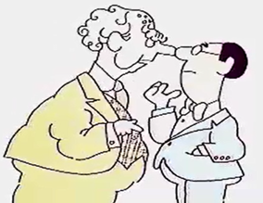
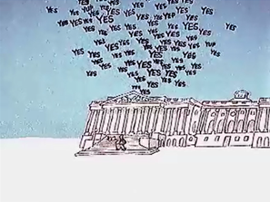
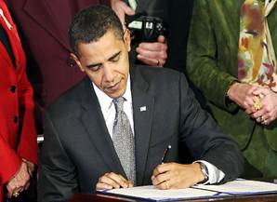
How a Bill becomes a Law
12
Proposed
Signed or Vetoed

Slide 13
Powers and roles of the President
13
- Chief of State:
o Head of gov’t
- Chief Executive:
o Head of Executive branch
- Chief Legislator:
o Head of making laws
- Chief of Party:
o Head of his political party
- Chief Diplomat:
o Main representative for talking to other countries
- Commander-in-chief:
o Head of Military
President Influences Gov’t Policy
Proposes Legislation (laws)
Appeals to the people (TV, “state of the union”)
Sign or Veto Laws
Appoints Judges and Officials
Basic Jobs
Proposes a Budget
Administers Federal bureaucracy

Slide 14
14
President
Vice President
Cabinet

Slide 15
15
U.S. Supreme Court
Appellate
Limited-Original
U.S. Circuit Court of Appeals
Appellate
DO OVER!!
U.S. District Court
Original

Slide 16
16
Criminal Law Procedure
Arrest with PROBABLE CAUSE (evidence)
Jailed or released on bail
Arraignment
Plea entered
Probable Cause is reviewed
Attorney may be appointed
Court date is set
Trial is conducted
Verdict
- Guilty verdict may be appealed to a higher court
Civil Case- Disagreement
between two parties
Plaintiff-The person who is suing
Defendant-The person being sued
Notes:
Defendant-The person being sued Plaintiff-The person who is suing Civil Case- Disagreement
Between two parties

Slide 17
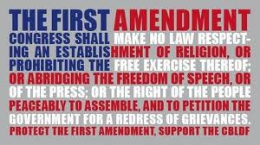
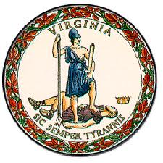
Amendments
17
4th-Freedom of:
Religion
Assembly
Press
Petition
Speech
5th-National gov’t
14th-State gov’t

Slide 18
VOTING!!!!!!
18
- Before you vote, you must register to vote (sign up)
- Qualifications to vote:
- Citizen of U.S.
- Citizen of state you’re voting in
- 18 years old by Election Day
- How to Register:
- sign up at:
- Registrar’s office
- DMV
- Library
- Gov’t office
- print online, and then Mail it
- Must be done 22 days before the election
Failure to vote because:
Age
Education
Failure to register
Income

Slide 19
19
Similarities of Political Parties
- Republicans & Democrats
1. Organize to win elections
2. They influence public policy (laws)
3. Both show liberal and conservative views
- Liberal = equality & freedom
- Conservative = traditional
4. Define the party to win votes from the political “center”
Differences
- Platform = ideology
- The beliefs of the party

Slide 20
Political Parties
20
1. Recruit and Nominate candidates
- The pick
2. Educate the voters about campaign issues
- TV ads talking about high electric bills
3. Helping Candidates Win elections
- $$$
4. Monitor actions of officeholders
- Candidate must vote for bills the Party likes
- If not – No $$$

Slide 21
Interest group and Lobbyist
21
Interest Group-Give Money to Politicians
Lobbyist- Employees of interest groups
Public Policy:
Tv
Radio
Newspaper
Internet

Slide 22
Electoral College
22
Process for electing the Prez and V.P.
Not a popular vote (most votes in US)
How it works:
Candidate with the most votes in a state – wins the state
Winner-take-all
Favors a Two Party System
Each state is worth a certain amount of points
Points are based on population
State with a lot of people = a lot of pts (NY)
State with a few people = few pts (Hawaii)
Virginia = 13 pts. (11 reps + 2 Senators)
1st candidate to 270 points wins (51% of pts possible - 538)
Problems:
Candidates only care about states with large populations
(TX, CA, NY)
Democrats that live in states that always vote Republican
Why vote democrat in Alabama? Can’t win.
Result: Less People Vote

