Slide 1
SOL Review Booklet
By Kimberly Holcomb

Slide 2
Table of Contents
Unit 1: Foundations of Government………………………….3-5
Unit 2: Constitutional Government…...………………………6-9
Unit 3: The Legislative Branch(Congress)……....……….…10-12
Unit 4: The Executive Branch(President)…………………..13-14
Unit 5: The Judicial Branch(Federal Courts)………………15-17
Unit 6: People and Politics………………………………..18-22

Slide 3
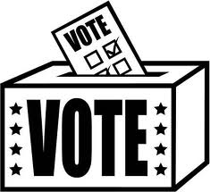
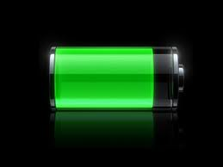
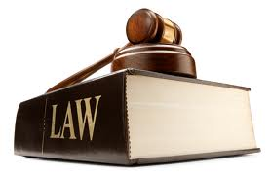
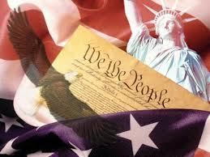
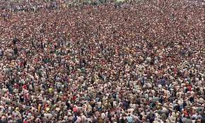
Page#3
The 5 Principles of the U.S. Government Page#3
Consent of the Governed
Representative Government
Limited Government
Democracy
Rule of Law
People elect representative to represent
them in government
People are the source of all power
Government is not all powerful
Government where the people rule
Everyone is under the law

Slide 4
Page#4
Significant Documents
Virginia Charter Company of London
Articles of Confederation
Virginia Statute for Religious Freedom
Declaration of Independence
Virginia Declaration of Rights
-grievances
-independence
-equality
-life, liberty, pursuit of happiness
-Weak central gov’t
-1st national gov’t
-strong states
-No prez, taxes currency, enforce laws
-life, liberty& property
-Model for Bill of Rights and Dec. of Indy.
-1st rep. gov’t
-Guaranteed rights of Englishmen
-Believe in what you want

Slide 5
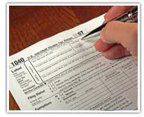
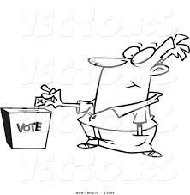
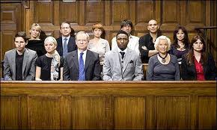
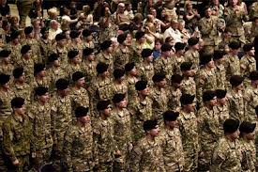
Page#5
14th Amendment
Birth
Citizenship
Naturalization
Civic Duties (Mandatory)
Civic Responsibilities (Voluntary)
-Obey the law
-Pay taxes
-Serve in Military (if called)
-Serve in jury (if called)
-Register to vote
-Participate in political campaigns
-volunteer
-respect different opinions

Slide 6
Checks and Balances, Separation of Powers, and Federalism
Page#6
Checks and Balances: Each branch of the government checks each other to make sure one branch doesn’t have more power than the other two.
Separation of Powers: separate the into three branches.
Federalism: Dividing power between national and state.

Slide 7
6 goals of the Preamble
Page#7
We the People
To form a more perfect union
Establish justice
Domestic tranquility
Common defense
Promote the general welfare
Blessings of liberty
Consent of the Governed
Kill Articles of Confederation
Fair courts and laws
Peace in USA
Protect from other countries
Make our lives better
Protect our rights

Slide 8
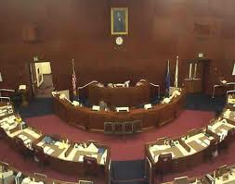
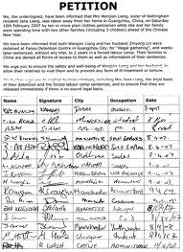
The 1st Amendment
Page#8
Freedom of:
Religion
Assembly
Press
Petition
Speech

Slide 9
Amending the Constitution
Page#9
National Congress Proposes
States
Vote
State Demanded
Convention
Proposes
General Assembly Proposes
Voters
Convention
Proposes

Slide 10
The Senate
Page#10
100
Members

Slide 11
House of Representatives
Page#11
435
Members

Slide 12
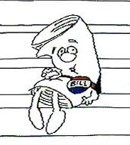
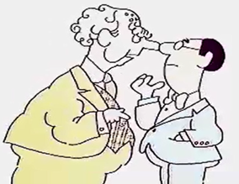
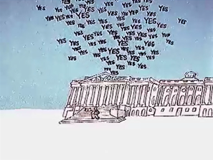
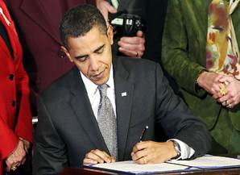
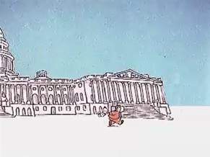
How a Bill becomes a Law
Page#12

Slide 13
Powers and Roles of the President
Page#13
Chief of State:
o Head of gov’t
Chief Executive:
o Head of Executive branch
Chief Legislator:
o Head of making laws
Chief of Party:
o Head of his political party
Chief Diplomat:
o Main representative for talking to other countries
Commander-in-chief:
o Head of Military
Proposes Legislation (laws)
Appeals to the people (TV, “state of the union”)
Sign or Veto Laws
Appoints Judges and Officials
Proposes a Budget
Administers Federal bureaucracy

Slide 14
Page#14
President
Vice President
Cabinet

Slide 15
Page#15
Appellate
Limited-Original
U.S. Supreme Court
Court of Appeals
Appellate
U.S. District Court
original

Slide 16
Page#16
Criminal Law Procedure
1. Arrest with PROBABLE CAUSE (evidence)
2. Jailed or released on bail
3. Arraignment
a. Plea entered
b. Probable Cause is reviewed
c. Attorney may be appointed
d. Court date is set
4. Trial is conducted
5. Verdict
- Guilty verdict may be appealed to a higher court
Civil Case: disagreement between two parties
Plaintiff: the person who is suing the defendant
Defendant: the person being sued

Slide 17
4th Amendment
5th Amendment
Page#17
Freedoms
Religion
Assembly
Press
Petition
Speech
National Government
14th Amendment
State Government

Slide 18
- Before you vote, you must register to vote (sign up)
- Qualifications to vote:
- Citizen of U.S.
- Citizen of state you’re voting in
- 18 years old by Election Day
- How to Register:
- sign up at:
- Registrar’s office
- DMV
- Library
- Gov’t office
- print online, and then Mail it
- Must be done 22 days before the election
-Reasons people fail to vote:
-Age
-Education
-Income

Slide 19
Similarities of Political Parties
- Republicans & Democrats
1. Organize to win elections
2. They influence public policy (laws)
3. Both show liberal and conservative views
- Liberal = equality & freedom
- Conservative = traditional
4. Define the party to win votes from the political “center”
Page#19
Differences
-Platform = ideology
- The beliefs of the party

Slide 20
Page#20
Functions of Political Parties
1. Recruit and Nominate candidates
- The pick
2. Educate the voters about campaign issues
- TV ads talking about high electric bills
3. Helping Candidates Win elections
- $$$
4. Monitor actions of officeholders
- Candidate must vote for bills the Party likes - If not – No $$

Slide 21
Page#21
Interest Groups, Lobbyist, Public Policy
Interest Group: gives money to politicians
Lobbyist: employees of the interest groups
Public Policy:
-TV
-Radio
-Internet
-Newspaper

Slide 22
Page#22
Electoral College
Process for electing the President and Vice President
Not a popular vote (most votes in US)
How it works:
Candidate with the most votes in a state – wins the state
-Winner-take-all
-Favors a Two Party System
Each state is worth a certain amount of points
-Points are based on population
-State with a lot of people = a lot of points (NY)
-State with a few people = few points (Hawaii)
-Virginia = 13 pts. (11 reps + 2 Senators)
1st candidate to 270 points wins (51% of points possible - 538)

