Slide 1
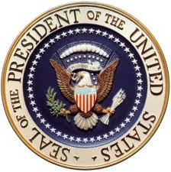
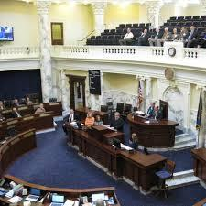
Legislative
congress approves appointments and budgets and can impeach the executive branch
executive
executive checks the legislative branch by vetoing laws, calling congress into special sessions, and proposing laws
the executive checks the judicial branch by appointing federal judges and justices
Court can declare law unconstitutional
judicial
congress approves appointments and can impeach the judicial branch
courts can declare presidential acts unconstitutional

