Slide 1
Where does the price of a good or service come from?

Slide 2
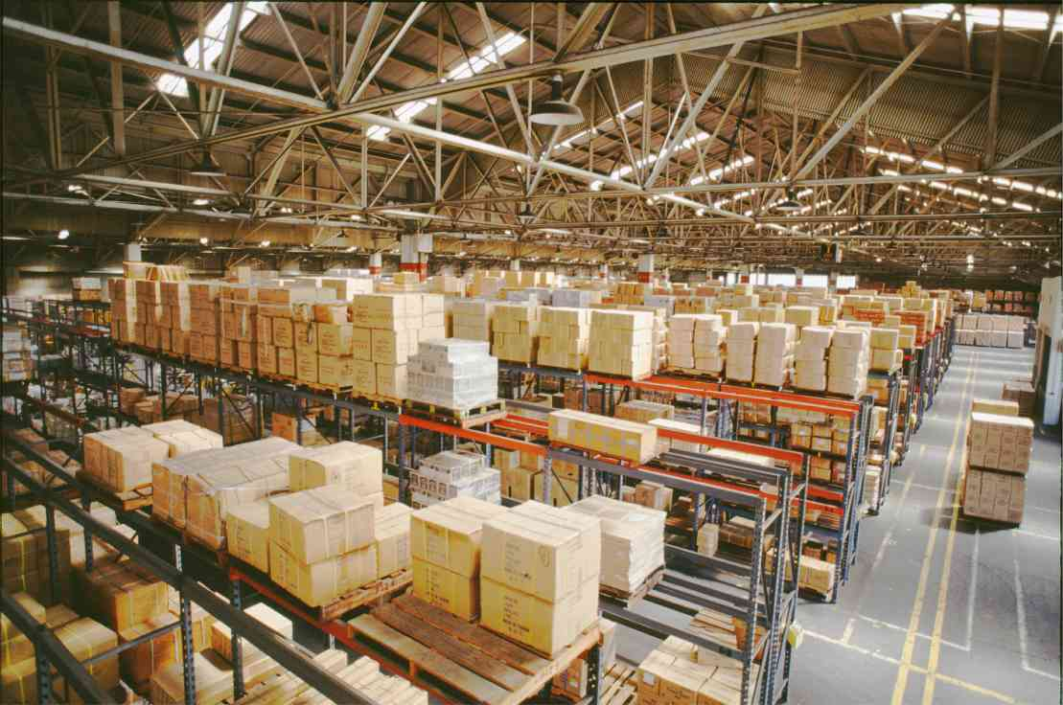
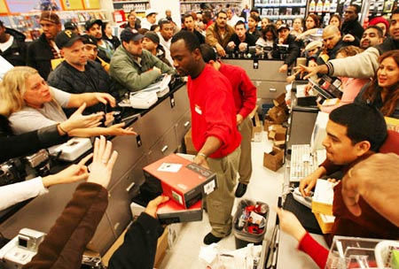
Economic Concepts
Supply and Demand
  Determines Prices
Supply
Demand

Slide 3
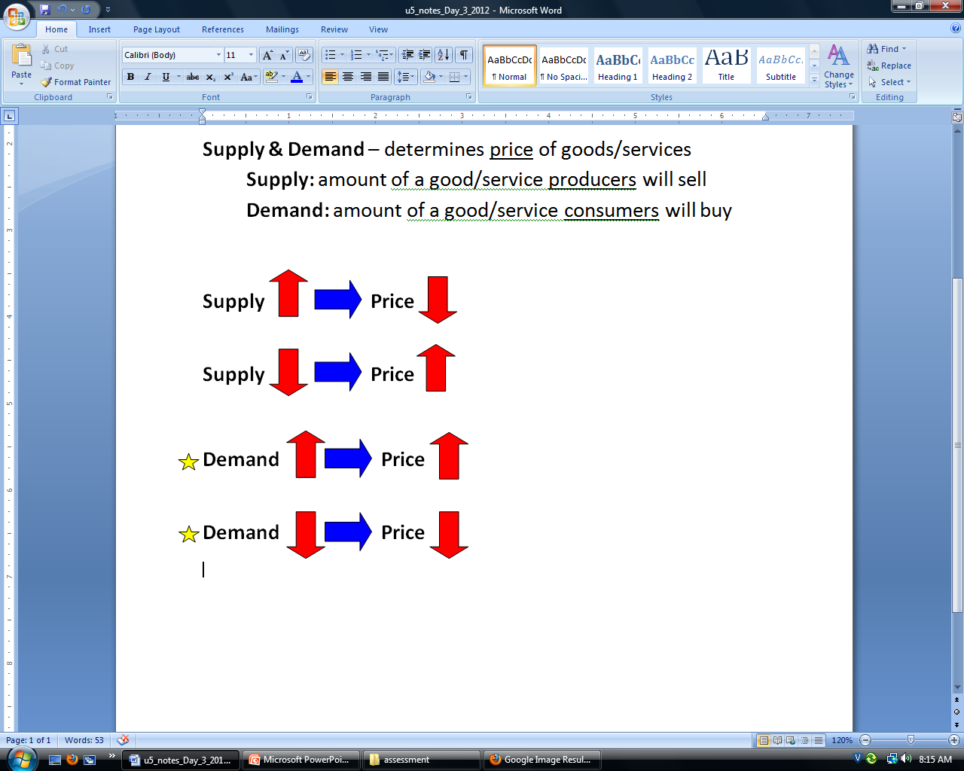
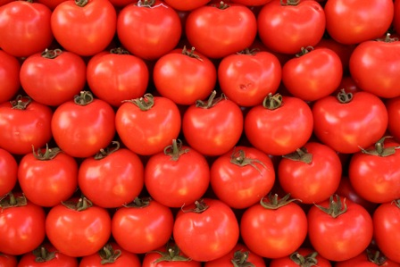
Supply
You own a tomato business
This year’s harvest was great, the supply is High
You have too many tomatoes, you have to get rid of them fast
You will lower the price to get them to buy

Slide 4
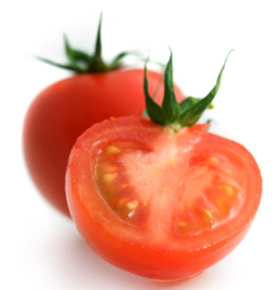
Supply
You own a tomato business
This year’s harvest was bad, the supply is Low
Tomatoes are scarce
If people want them they will fight for them
You will raise the price to make more money

Slide 5
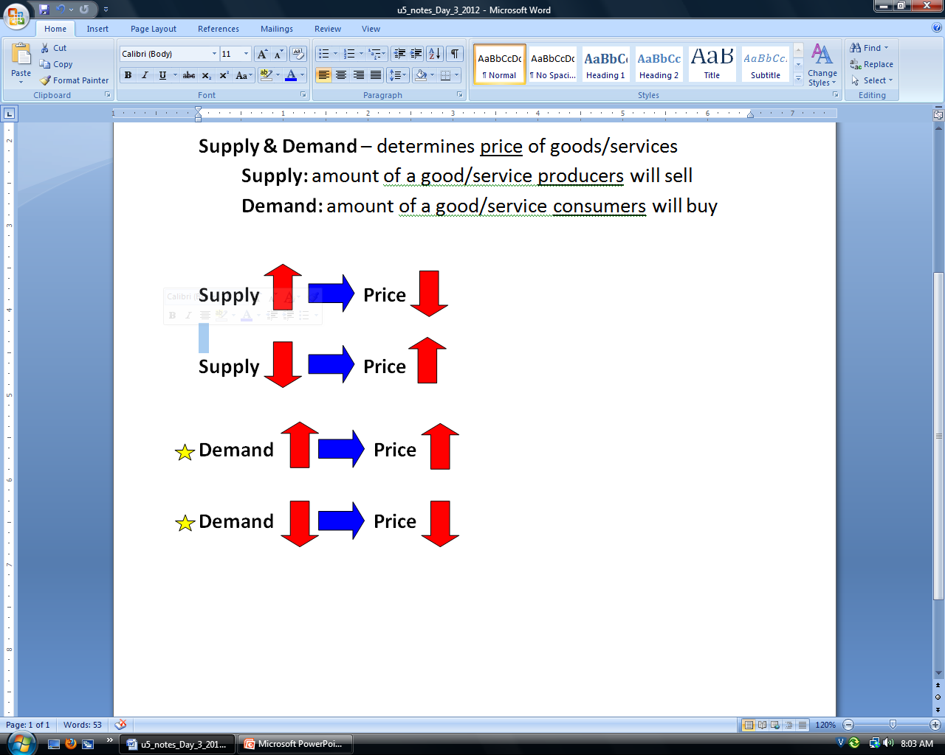
Demand
You own a business
People LOVE your product, the demand is High
You will Raise the Price to make more money

Slide 6
Demand
You own a business
People HATE your product, the demand is Low
You will lower the price to get them to buy

Slide 7
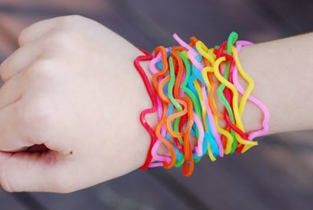
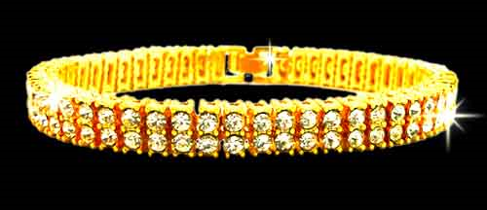
Supply and Demand
High Supply …Low Price
Low Supply …High price
Silly Bands
Flip Flops
Chevy Aveo
32 inch HDtv
Gold Bracelets
Pair of Jordan's
Bugatti
108 inch HDtv

Slide 8
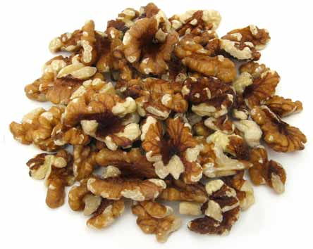

Supply and Demand
High Demand …hIGH Price
Low Demand …low price
iPad
Fuel Efficient Cars
Pistachios
Coby Tablet
Gas Guzzler Cars
Walnuts

Slide 9
Supply and Demand
Supply
Demand

Slide 10
Economic Concepts
Supply
Supply
$10
Price
$9
$8
$7
1
2
3
4
Quantity

Slide 11
Economic Concepts
Demand
$10
Price
$9
$8
$7
1
2
3
4
demand
Quantity

Slide 12
Economic Concepts
Supply and Demand
Supply
$10
Price
$9
$8
$7
1
2
3
4
demand
Quantity

Slide 13
Economic Concepts
Supply and Demand
Supply
$10
Price
$9
$8
$7
1
2
3
4
demand
Quantity

Slide 14
Economic Concepts
Supply and Demand
Surplus
You made too many
Supply
$10
1 pizza
X $9
$9
Price
$9
$8
$7
throw out
on 2 extras
1
2
3
4
demand
Quantity

Slide 15
Economic Concepts
Supply and Demand
Supply
$10
Price
$9
$8
$7
1
2
3
4
demand
Quantity

Slide 16
Economic Concepts
Deficit
made too few
Supply and Demand
Supply
$10
1 pizza
X $7
$7
Price
$9
$8
$7
Missed out
on 2 sales
1
2
3
4
demand
Quantity

Slide 17
Economic Concepts
Supply and Demand
Equilibrium
Supply
$10
Price
$9
$8
$7
1
2
3
4
demand
Quantity

Slide 18
Economic Concepts
Supply and Demand
Equilibrium
Supply
$10
2 pizza
X $8
$16
Price
$9
$8
$7
perfect
1
2
3
4
demand
Quantity

Slide 19
Supply and Demand
How many Pizza Places in Rocky Mount?
  Pizza Hut
  Pizza King
  Little Caesar’s
  Papa John’s
  Domino’s
  Hema’s
  Frank’s
  Pyramid
Large Supply of Pizza!!!

Slide 20
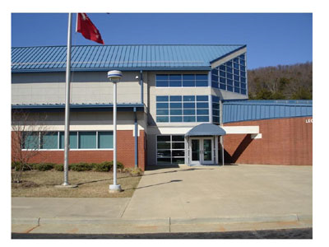

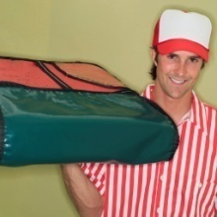
Supply and Demand
What happens next?
Let’s Open a Pizza Place!
  Gereau’s Pizza

Slide 21
Rocky Mount Pizza
Supply and Demand
Supply
Price
$15
$10
$10
$5
1
2
3
4
demand
Quantity Sold

Slide 22
After Gereau Pizza
Supply goes up
Supply
Price
$15
$10
$5
1
2
3
4
demand
Quantity Sold

Slide 23
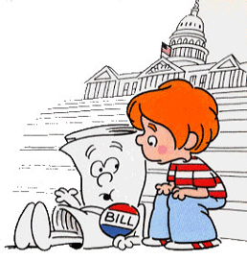
Economic Change
Town Council writes a new ordinance
  “All Pizza must use FRESH INGREDIENTS”
Most pizza places go out of business
Supply goes DOWN

Slide 24
Economic Concepts
Supply goes down
Supply
Price
$15
$10
$5
1
2
3
4
demand
Quantity Sold

Slide 25
Economic Concepts
Supply and Demand
Supply
Price
$15
$10
$5
1
2
3
4
demand
Quantity Sold

Slide 26
Breaking News
Pizza is Healthy

Slide 27
Before Gereau Pizza
Demand Goes Up
Supply
Price
$15
$10
$5
1
2
3
4
demand
Quantity Sold

Slide 28
Breaking News
Pizza is made from
Humans!!!

Slide 29
Before Gereau Pizza
Demand goes down
Supply
Price
$15
$10
$5
1
2
3
4
demand
Quantity Sold

Slide 30
Supply and Demand
If you buy goods
or
If you sell goods

