Slide 1
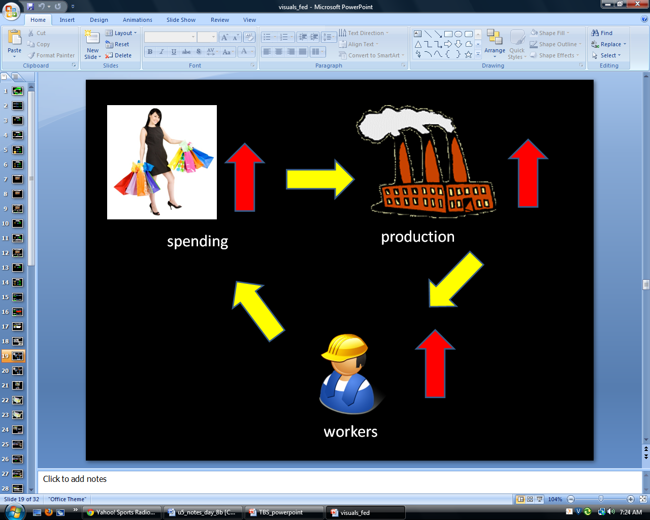
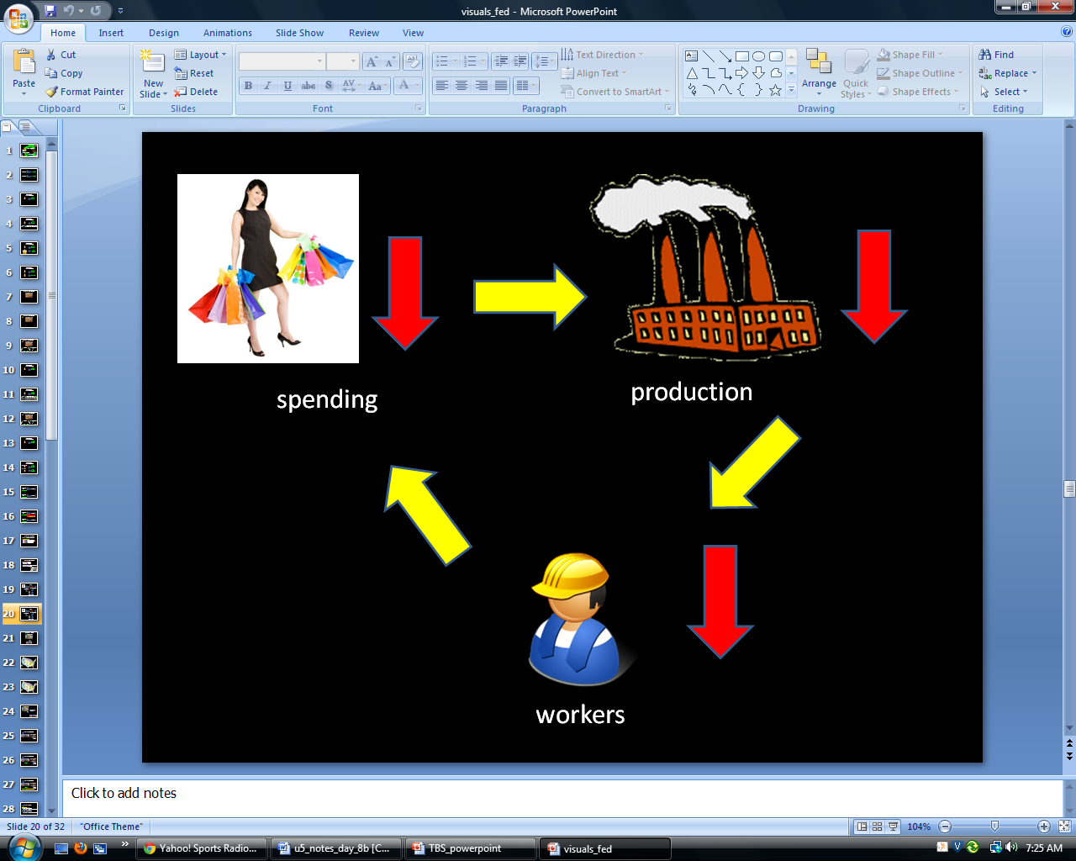
GOOD
BAD

Slide 2
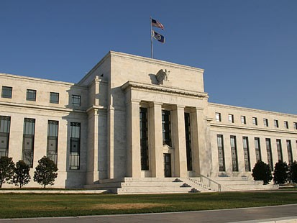
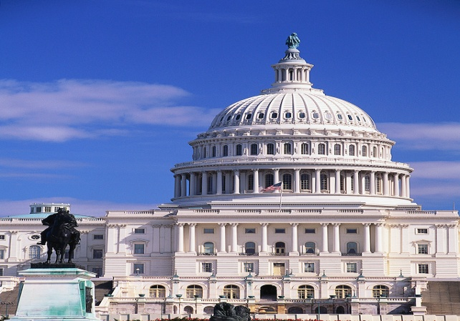
Federal Reserve
Government
THE FED
Prints Money
Can affect economy
Can Change:
  Interest Rates
  Bank’s Requirement
Does NOT print Money
Can affect economy
Can Change
  Taxes
  Spending
  Borrowing

Slide 3
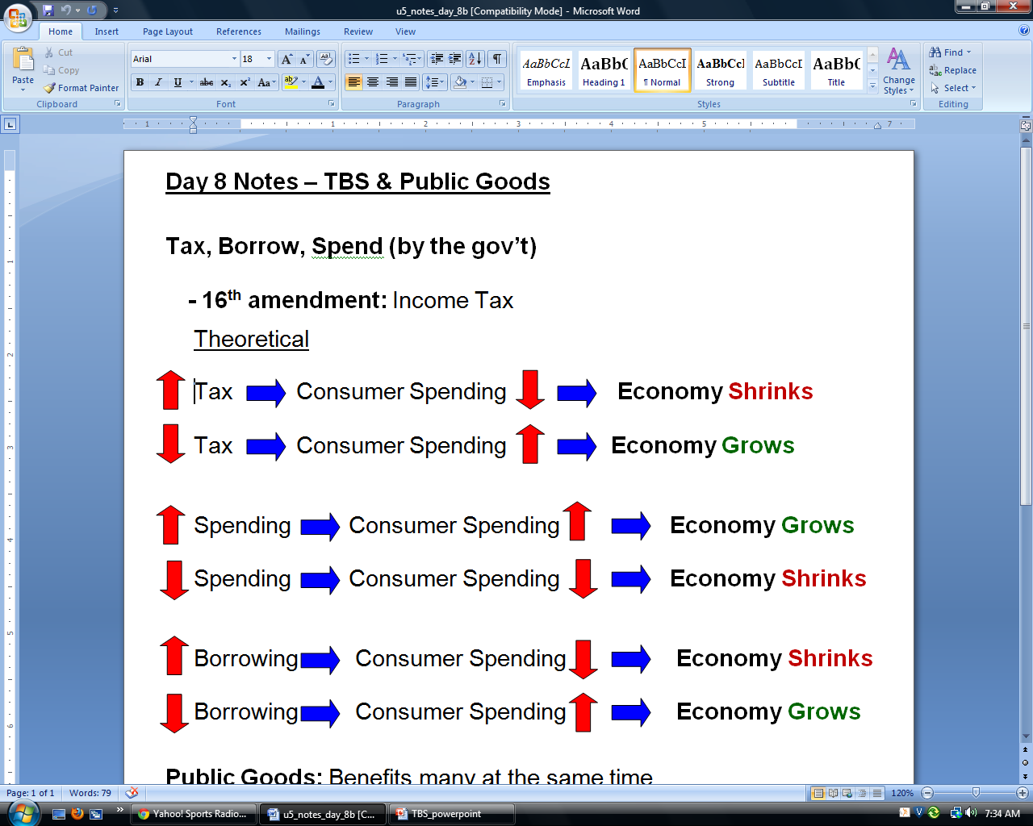
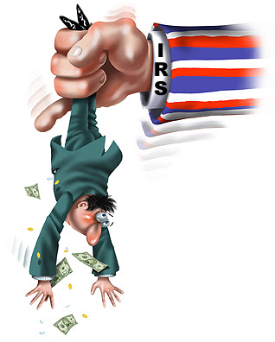
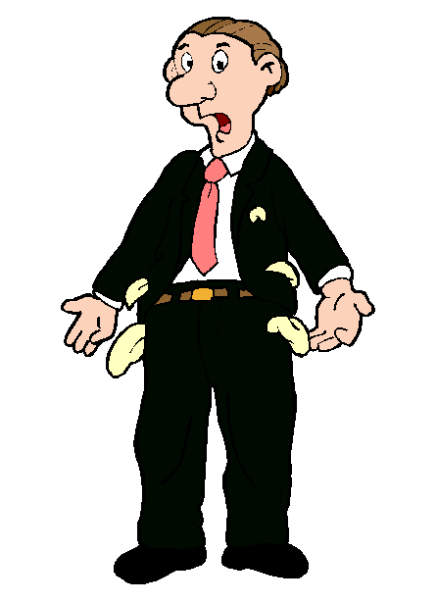
Taxes

Slide 4
BAD

Slide 5
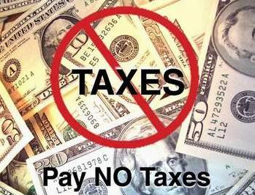
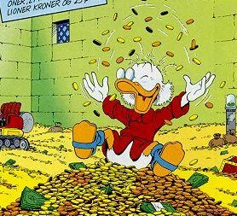
Taxes

Slide 6
GOOD

Slide 7


Government Spending

Slide 8
GOOD

Slide 9
Government Spending

Slide 10
BAD

Slide 11
Government Borrowing
The Government does NOT print money
If they need it, they borrow it (just like us)
  Savings Bonds:
    Government borrows from US Citizens
    Government borrows from China
    Government borrows from anyone

Slide 12
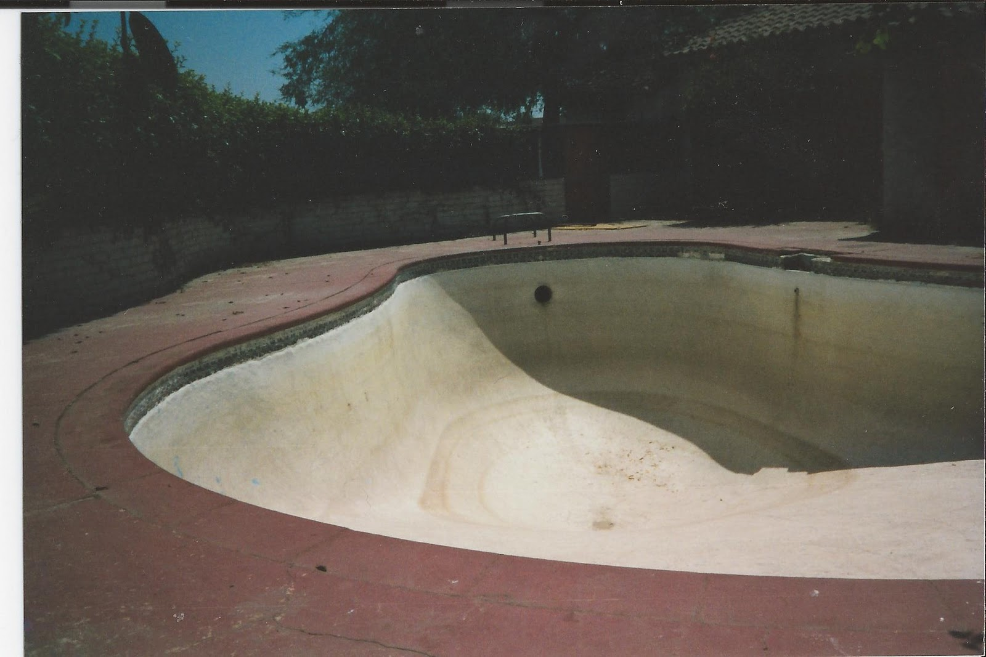
Government Borrowing

Slide 13
Government Borrowing

Slide 14
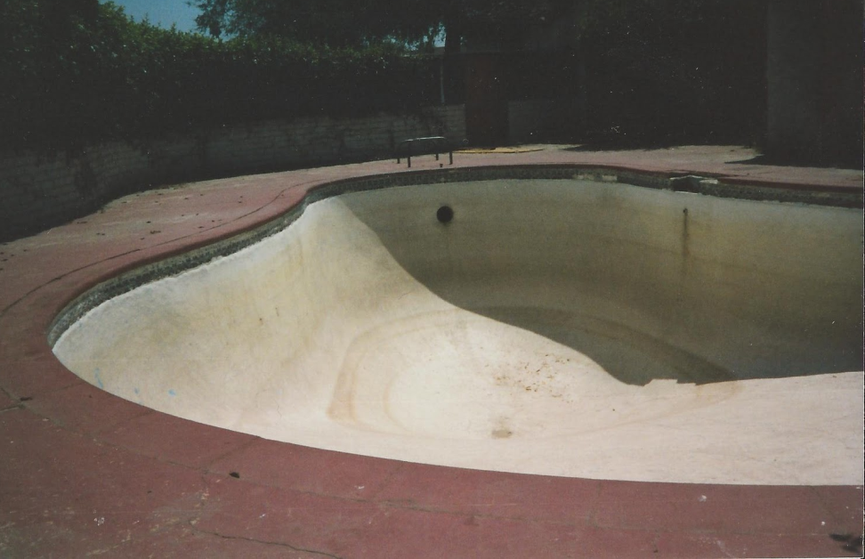
Government Borrowing

Slide 15
BAD

Slide 16
Government Borrowing

Slide 17
GOOD

Slide 18
Public Goods
Something that benefits many people at the same time, and anyone can use it
  Non-rivalrous
    Multiple people can use it at the same time
    Roads, Lighthouse, Military
  Non-excludable
    Roads, Parks, Lakes, Military

Slide 19
Public Goods
Shoes are not a public good
  They are Rivalrous
    Only one person can wear a pair of shoes at a time
  They are Excludable
    If you want shoes, you have to pay for them

Slide 20

Public Goods
Jones
Johnson
Roberts
Smith
Hodges

Slide 21
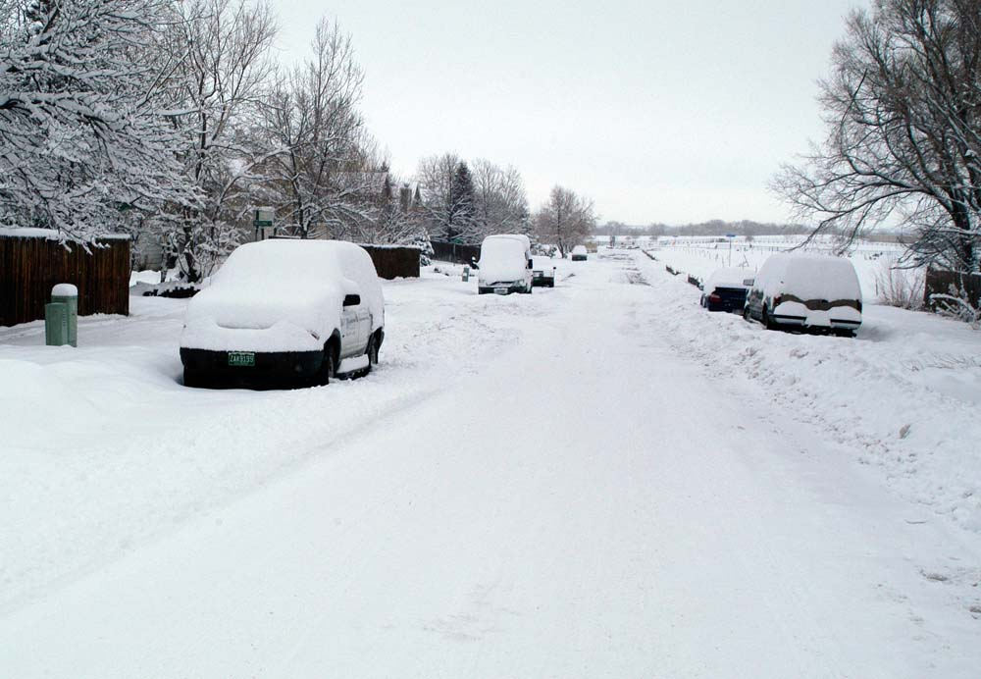
Public Goods

Slide 22
Public Goods
Jones
Johnson
Roberts
Smith
Hodges

Slide 23
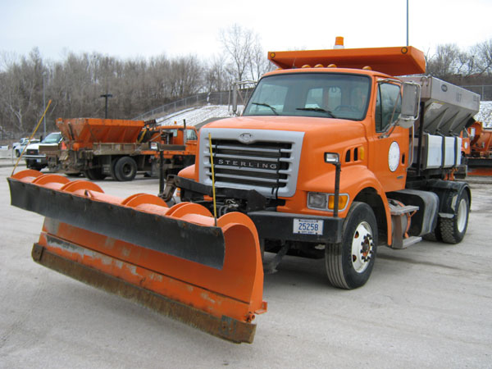
Public Goods

Slide 24
Public Goods
Jones
Johnson
Roberts
Smith
Hodges

Slide 25
Public Goods
Jones
Johnson
Roberts
Smith
Hodges

Slide 26
Public Goods
Jones
Johnson
Roberts
Smith
Hodges

Slide 27
Public Goods
Jones
Johnson
Roberts
Smith
Hodges

Slide 28
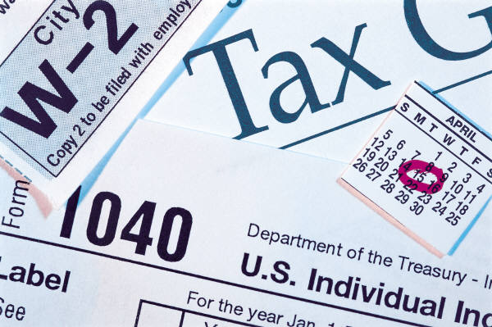
Public Goods
Free Riders
  How do we make sure everyone pays???
  TAXES

Slide 29

Public Goods
FCHS needs a new school building
  Taxes
If no taxes, people would have to pay
Some people wouldn’t pay, and there kids would still use the school
  Freeriders!

Slide 30
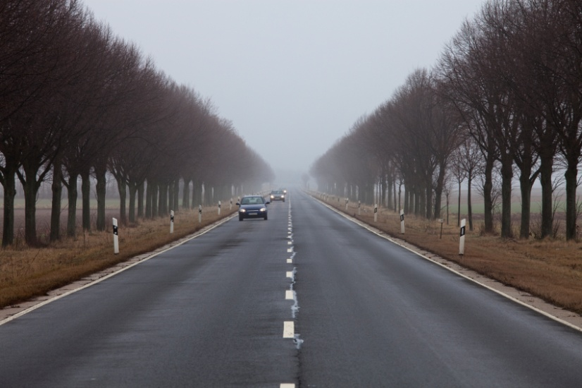
Public Goods
Highway to Blacksburg from Rocky Mount
  Taxes
If no taxes, people have to pay
How do we make sure only the people that paid get to use the road?
  Impossible

