Slide 1
The Fed

Slide 2

Inflation
the devaluation of money
$1
$1
$0.20
Let’s change the supply of candy.
Let’s increase it and see what happens.

Slide 3
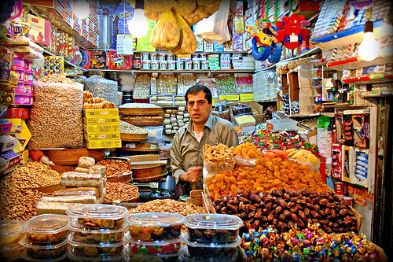
Steve’s Candy Shop
c
Selina
Bruce
Miranda
$1
$3
$2

Slide 4
Inflation the devaluation of money
$3
Let’s change the supply of money.
Let’s increase it and see what happens.
Everyone should be able to buy candy!

Slide 5
Steve’s Candy Shop
Selina
Bruce
Miranda
$1
$3
$2
$4
$6
$5

Slide 6
Inflation the devaluation of money
$6

Slide 7
Inflation the devaluation of money
$3
before
$3
after

Slide 8
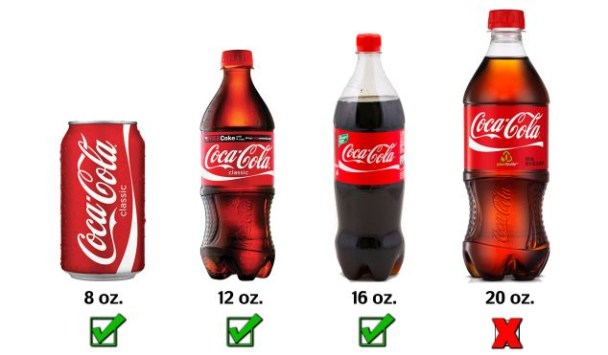
didn’t exist
.99
2000
.50
.75
.99
1.40
2012

Slide 9
Supply
of
Money
Value
Supply
of
Money
Value

Slide 10
Inflation
phenomenon
Money is made up, we created it w/our minds
So a dollar is worth, what we THINK it is worth
  Businesses know:
    Money Supply is always increasing
    Supply of Goods is not
      They will charge more

Slide 11
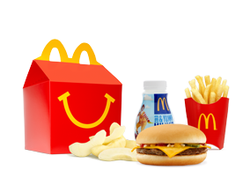


$3
$1000 Beef
Businesses understand Supply and Price
$6
$3
$2000 Beef

Slide 12



What happens if banks loan MORE money?

Slide 13
Loan
spend
ECONOMY
GROWS
make
hire
inflation

Slide 14
Loan
spend
ECONOMY
Shrinks
make
Stops
inflation
hire

Slide 15
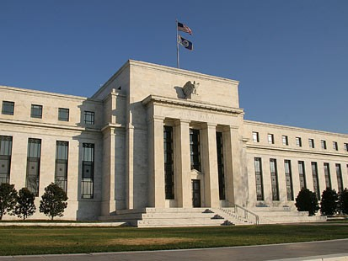
The Fed

Slide 16



Economic Flow
Consumer expenditure
Circular
Flow
Model
Households
Firms
inflation
Wages, rent, dividends

Slide 17
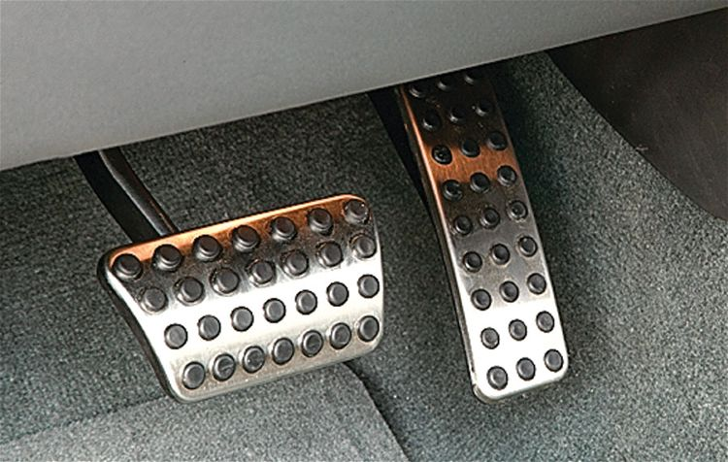
The Fed
Brake:
Take money out of the economy
Stop inflation
Gas:
Put money into the economy
the economy will grow
Economy stops growing
inflation

Slide 18
The Federal Reserve
Manages the amount of money in the economy
More $
Less $
Stimulate
  People Spend more
  Businesses produce more
  More Jobs
  Economy grows
  Inflation rises
Slow Down
  People Spend Less
  Businesses produce less
  Less Jobs
  Economy Shrinks
  Inflation stops

Slide 19
The Fed
Two Functions:
  Raise or Lower Interest Rates
  Raise or Lower a Bank’s reserve

Slide 20
Interest
Borrowing
  Low Interest Rate is good
  $100,000 at 1% interest
    You owe $1,000,000 plus $100,000
Borrowing
  High interest is bad
  $100,000 at 10% interest
    You owe $1,000,000 plus $100,000
Rule:
The lower the interest, the more you will borrow

Slide 21
The Fed

Slide 22
Economic Flow
Consumer expenditure
Circular
Flow
Model
Households
Firms
inflation
Wages, rent, dividends

Slide 23
The Fed
Lower interest rates
stimulate economy
Yes, Please!
Yes, Please!
Low interest rate
Bank will borrow more $
More Money for people
More Spending

Slide 24
Economic Flow
Consumer expenditure
Circular
Flow
Model
Households
Firms
What about
inflation
Wages, rent, dividends

Slide 25
The Fed
Raise interest rates
slow down the economy
No, thank you.
No, thank you.
Raise interest rate
Bank will borrow less $
Less Money for people
Stops inflation

Slide 26
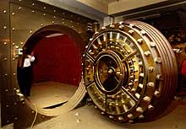
The Fed
Lower Bank’s reserve
stimulate economy
$10 million into the economy
$35 million
$25 million

Slide 27
The Fed
Raise Bank’s reserve
Slow Down economy
$10 million out of the economy
$35 million
$45 million

Slide 28
The Fed
Brake:
Take money out of the economy
Stop inflation
Gas:
Put money into the economy
the economy will grow
Economy stops growing
inflation

