Slide 1

Legislative
Executive
Congress
- Senate
- House of representatives
President
- Vice President
- Cabinet
National
General Assembly
- Senate
- House of delegates
Governor
- Lt. Governor
- Cabinet
State
Manager
- hired
county
Board of Supervisors
Local
city/town
Council
Mayor

Slide 2
Virginia
Courts
Va Supreme Court
-appeals
-limited-original
Justices
Va Court of Appeals
-appeals
Judges
Circuit
-felonies
-civil case (hi $)
-appeals
Judge
& Jury
General District
Juvenile &
Dom. Relations
-misdemeanors
-civil case (lo $)
Judge
Judge

Slide 3


NATIONAL
General Assembly
Lt.
Governor
Governor
of Virginia
Delegates

Slide 4
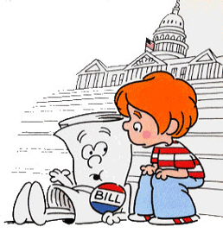


State Legislative (General Assembly)
Make Laws
Approve budget
Elect Judges
2
L

Slide 5

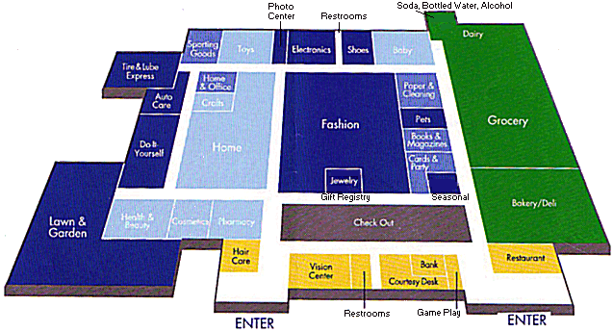
State Executive Branch (governor)
Enforce laws
Prepares the Budget
Appoints cabinet members
Grants pardons
Administers Bureaucracy
  “run the government”

Slide 6
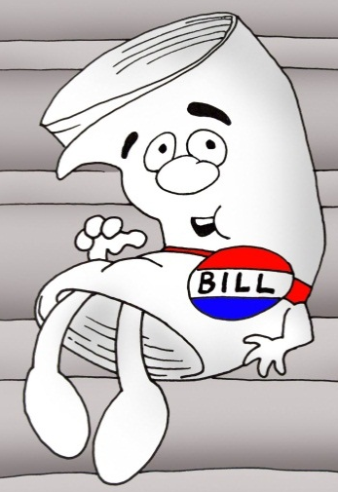

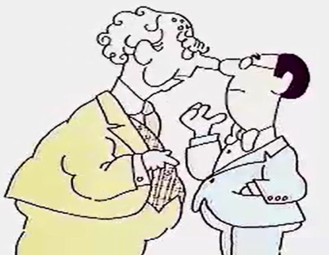
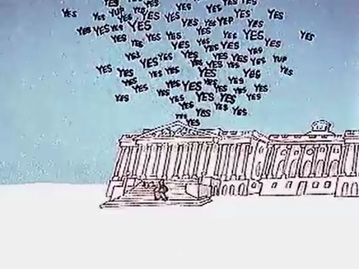
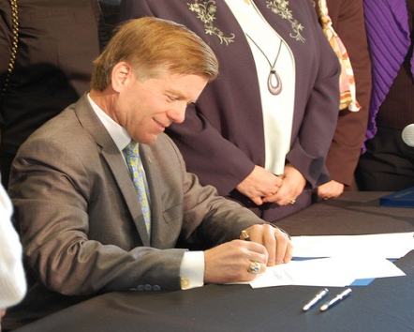
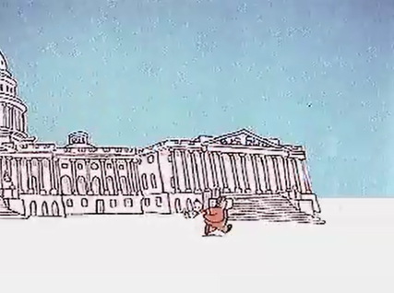
Bill
Introduced in
House #1
Sent to Committee
in House #1
Debated & Voted on
in House #1
proposed
Bill
Debated & Voted on
in House #2
Sent to Committee
in House #2
Introduced in
House #2
Governor
Signs or Vetoes

Slide 7



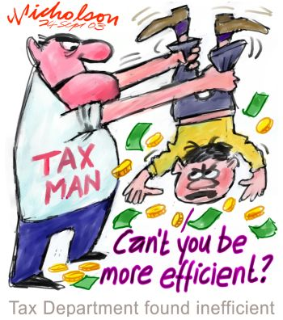
What do they have in common?
Sheriff
They
Are
Elected
Treasurer
Clerk of the Circuit Court
Commissioner
of the Revenue

Slide 8
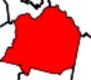
Most Power
National
State
Tension exists between the National and State Gov’t
Local

Slide 9
We need to help the poor. States must provide welfare to the needy.
Tensions
What? We can’t afford that!
Too Bad.
National
State

Slide 10
Foreign Policy (war)
Regulate Commerce (business)
  Foreign countries
  Between states
National
Schools
Public Health (Medicaid /Medicare)
Public Safety (police, firefighters)
Public Welfare
State
Serve local residents needs
Local

Slide 11
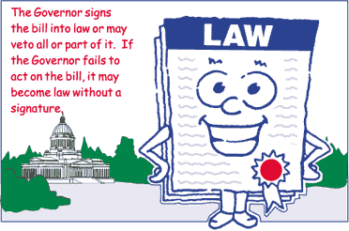
What is an Ordinance?
ORDINANCE

Slide 12
Legislative
Executive
Congress
- Senate
- House of representatives
President
- Vice President
- Cabinet
National
Biennial
(2 years)
General Assembly
- Senate
- House of delegates
Governor
- Lt. Governor
- Cabinet
State
Budget
Manager
- hired
county
Board of Supervisors
Local
city/town
Council
Mayor

Slide 13

Why does the State & Local government get power?
National
Constitution
10th
State
WHERE does the power come from?
Local

Slide 14
10th amendment
-reserves powers for the states
Constitution
10th

Slide 15
State
School Board
Power
run the school

