Slide 1
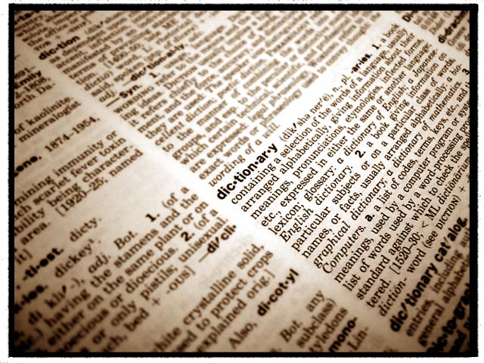
Unit 6 Visuals (day 1-2)
Economic Terms

Slide 2

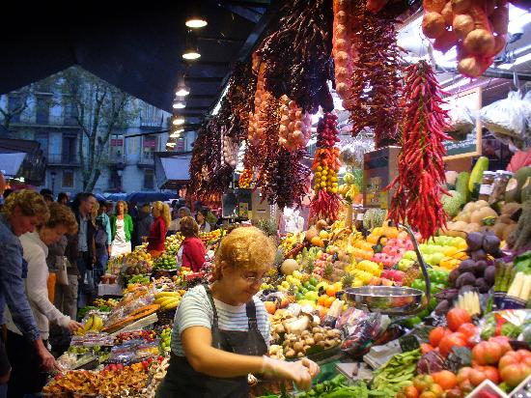
Economics
the study of choices involving goods…
  Production…Why do we make it?
  Distribution…Why do we exchange it?
  Consumption…Why do we buy/use it?

Slide 3
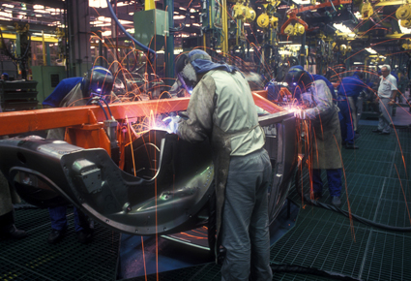
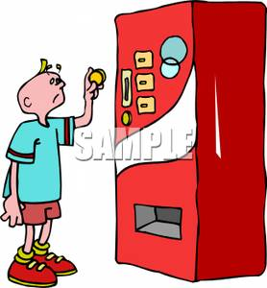
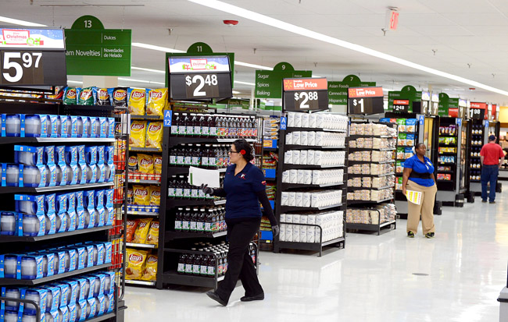
Economics: Studying…
Production = “making things”
  Cars, TVs, Music, Movies, iPods, beef
Distribution = “getting things to people”
  Semi-Trucks, Wal-Mart, Theaters, iTunes, McDonalds
Consumption = “buying things”
  Buying a car, a CD, a movie ticket

Slide 4
Economic Concepts
Scarcity
  Inability to satisfy all wants at the same time
  Resources and Good are limited
    Choices must be made
Example: HDtv
  2004 – Not many had an HDtv (scarce)
  2011 – Everyone has an HDtv (not scarce)
What are other things that are scarce?

Slide 5
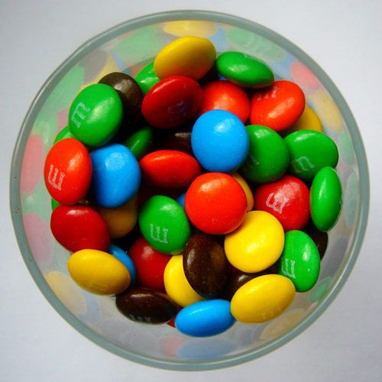
Which M&M is scarce?

Slide 6

What is scarce?

Slide 7
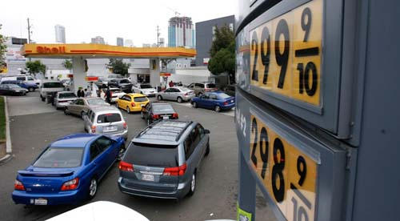
What is scarce?

Slide 8
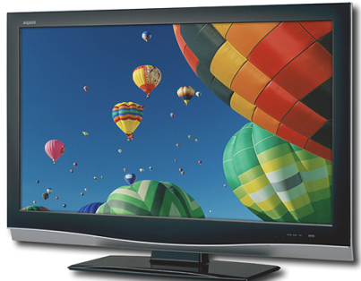
Economic Concepts
Choice
  Selecting an item or action from a set of alternatives
  Decisions are made by:
    Price – can you afford it?
    Quality – Is it good enough?
    Desire – How bad do you want it?
  Mr. Dietrich HDtv choice
    2007 – 32 inch TV = $800…no way!
    2011 – 32 inch TV = $288…maybe

Slide 9
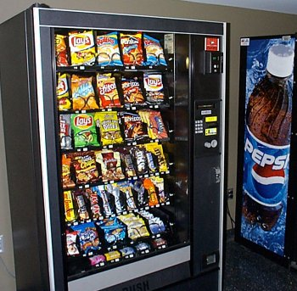
Choice
    Price
    Quality
    Desire

Slide 10


Choice
or
    Price
    Quality
    Desire

Slide 11
Choice
or
    Price
    Quality
    Desire

Slide 12
Economic Concepts
Resources
  Factors of production in producing goods and services
Example: HDtv
  Human: people build the TV
  Natural: Glass, Plastic, Noble gas
  Capital: Factory Building, Machines, $$$
  Entrepreneurship: Brains, Design & Sell the TV

Slide 13



Human Resources

Slide 14

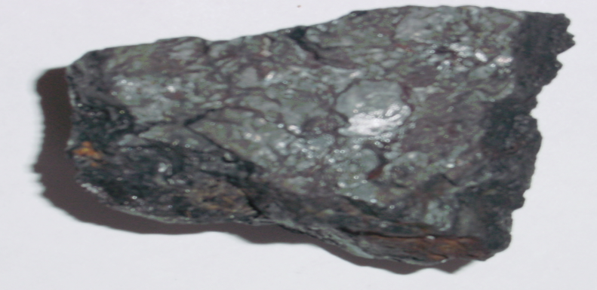
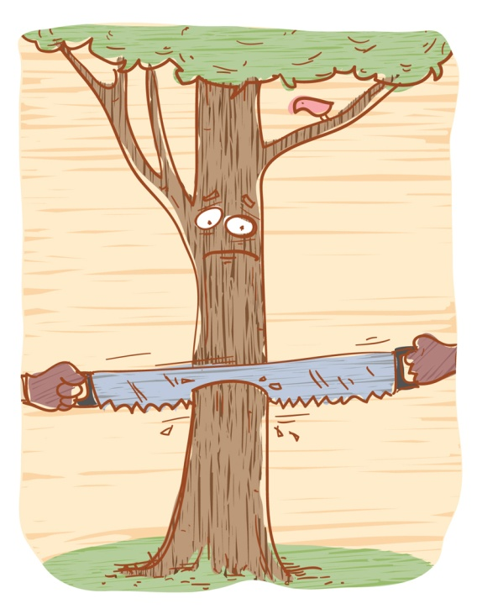

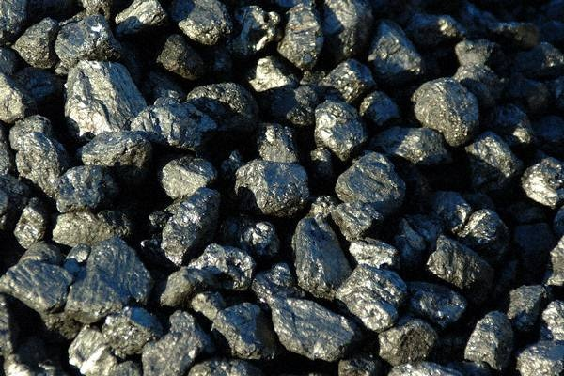
Natural Resources
“From Nature”

Slide 15

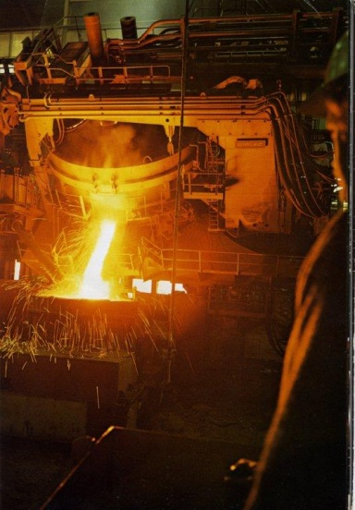

Capital Resources

Slide 16
Entreprenuership

Slide 17
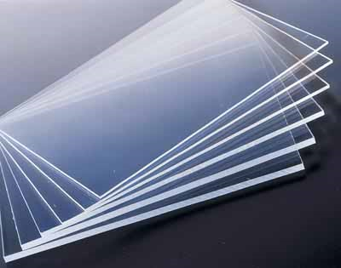
Economic Concepts
Production
  Combining entrepreneurship, human, natural, and capital resources to make goods or services
  Factory + plastic, glass, etc. + workers = HDtv
factory
glass
workers

Slide 18
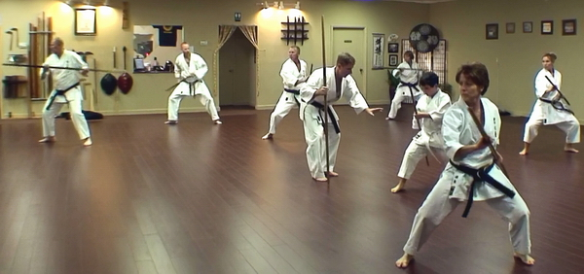
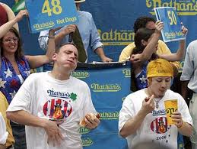

Economic Concepts
Consumption
  Using goods or services

Slide 19
Economic Concepts
Opportunity Cost
  That which is given up when a choice is made
    Quality vs. Low Cost
    Studying vs. Playing
    iPhone vs. Droid
    PS3 vs. XBOX360

Slide 20
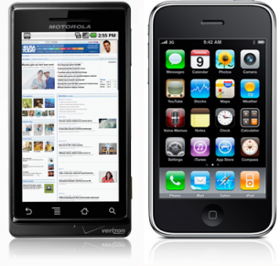
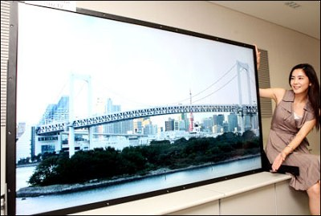
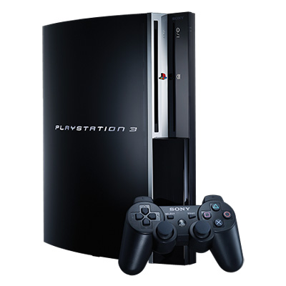
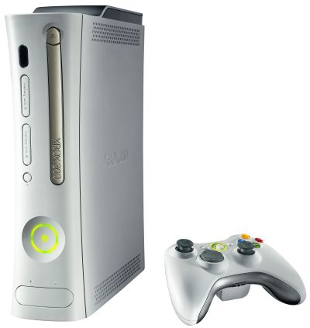
vs.
vs.
vs.

Slide 21
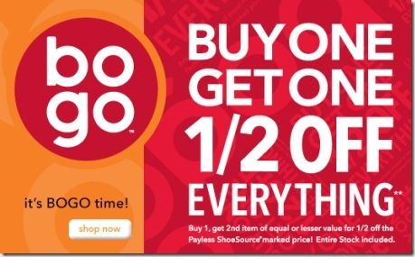
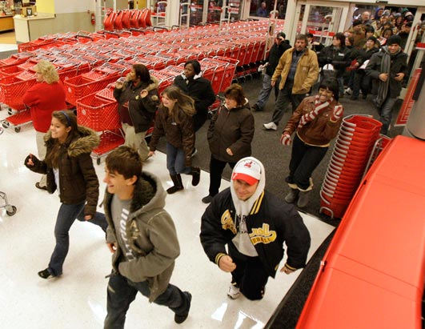
Economic Concepts
Incentive
  Things that incite or motivate a consumer’s economic behavior or to change economic behavior
    Examples:
      Sales
      Coupons
      Commercials
      Midnight Releases

Slide 22
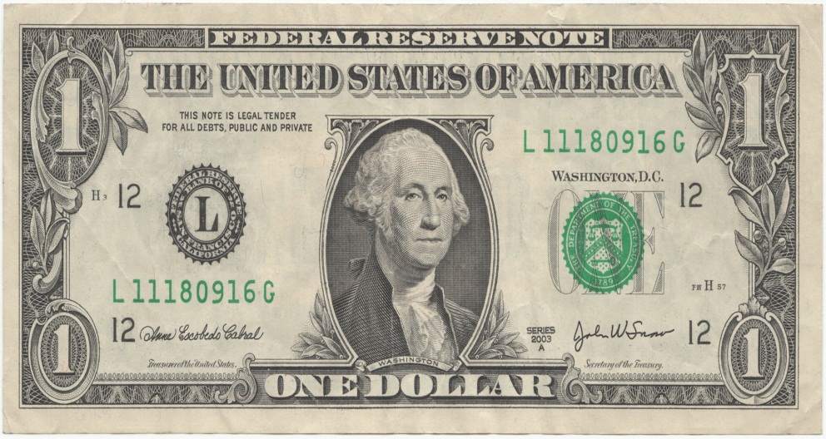
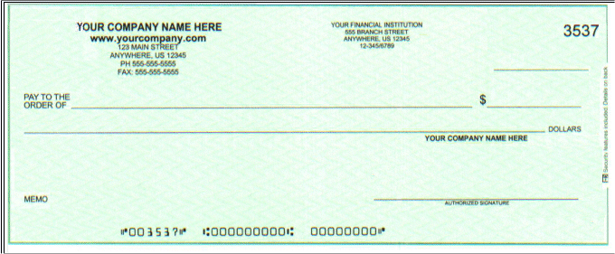
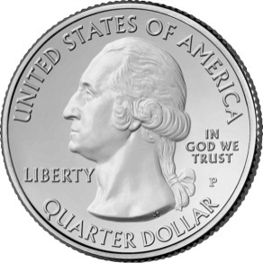
Economic Concepts
Money
  Currency
    Coins
    Dollars (federal reserve notes)
    Checks/Debit Cards
How was money invented?
Why is a dollar worth anything?

Slide 23
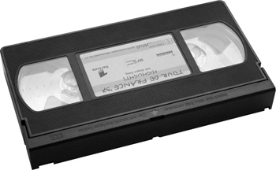
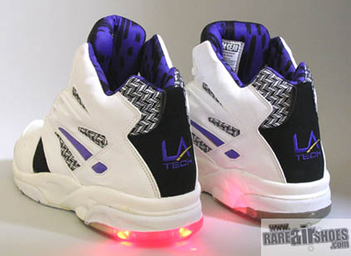
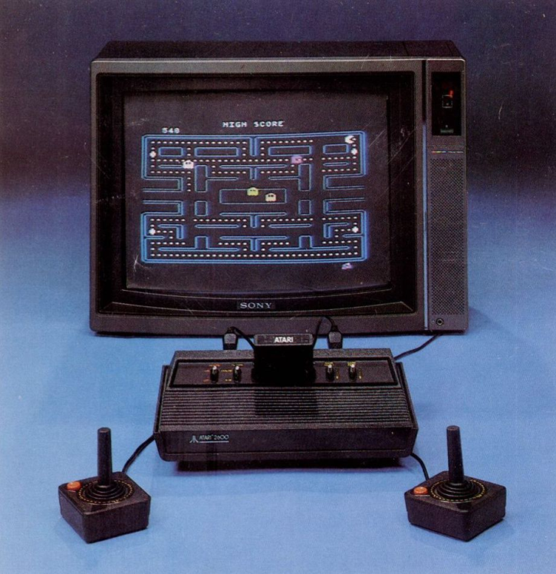
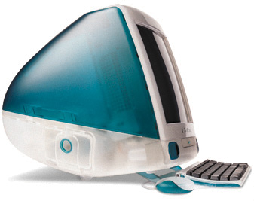
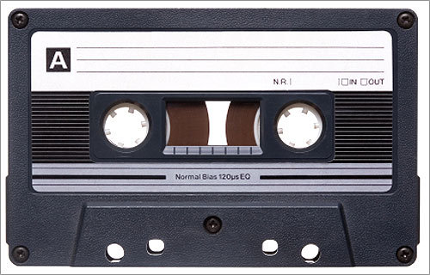
Consumer Sovereignty (power)
WE
WONT
BUY

Slide 24

Consumer Sovereignty (power)
WE
WANT

Slide 25
Economic Concepts
Consumer Sovereignty (consumer power)
  Consumers determine what products will be produced for sale
    Example:
      We buy HDtv, so HDtv are made
      We do not buy VCRs, so VCRs are no longer made

