Slide 1
Voter Registration
&
Voter Participation

Slide 2
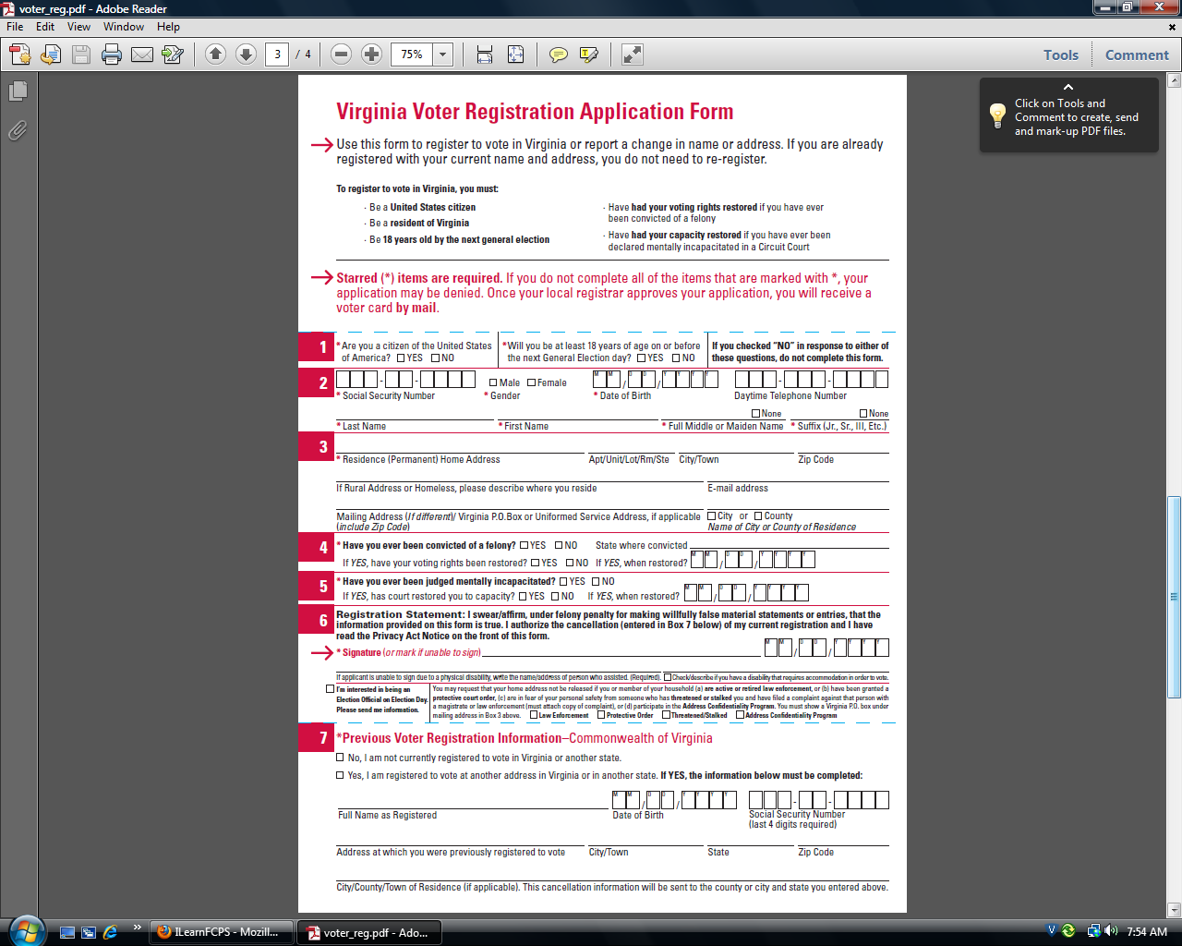

Slide 3
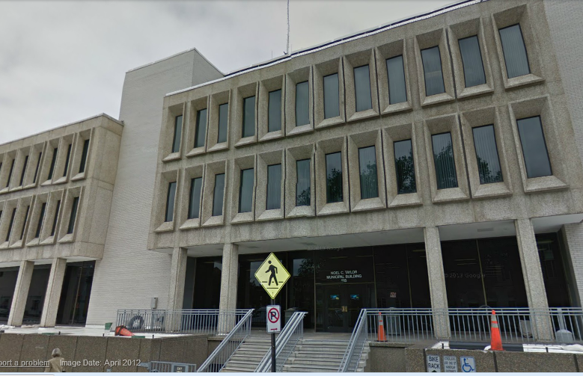
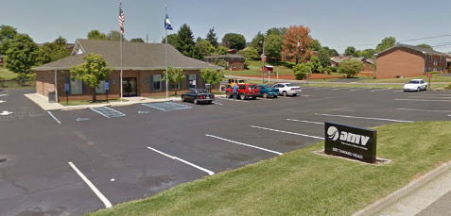
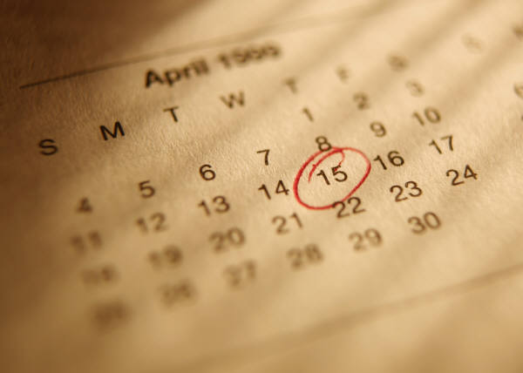
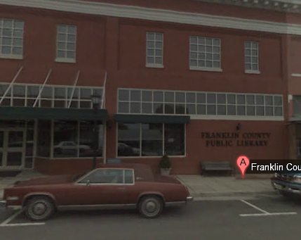
Where to Register?
22 days
Registrar’s Office
Dept. of Motor Vehicles
Library
Print from the internet, mail it in

Slide 4
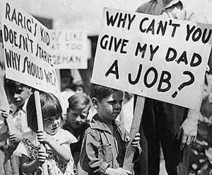
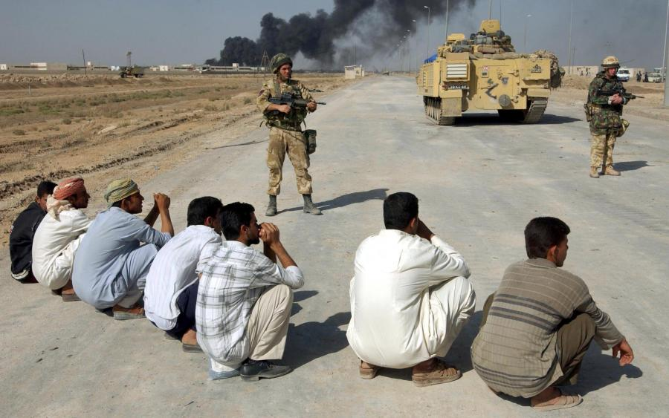
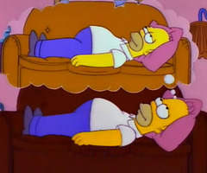
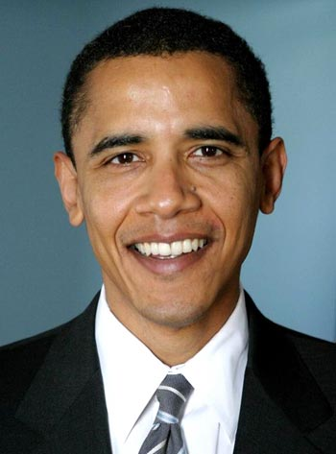
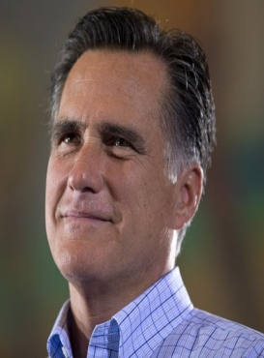
Highest Election Turnouts
turnout = people show up to vote
When there are Big Issues in America
  Economy
  War
When the President is up for election
People do not vote:
  Small Issues
  Non-Presidential elections
vs.

Slide 5
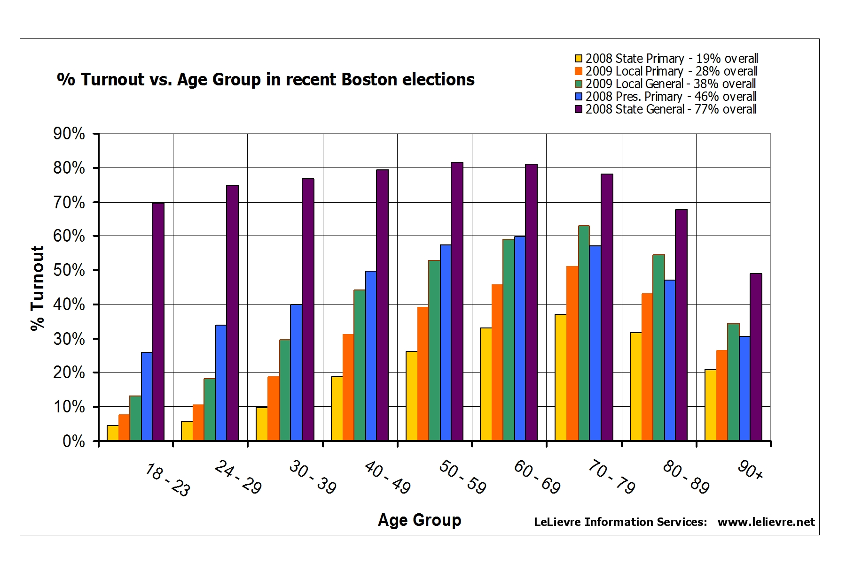
2008 = Presidential Election (purple)
2009 = Non-Presidential Election (green)

Slide 6
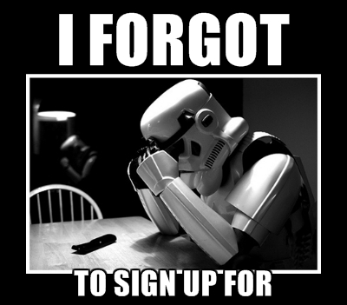
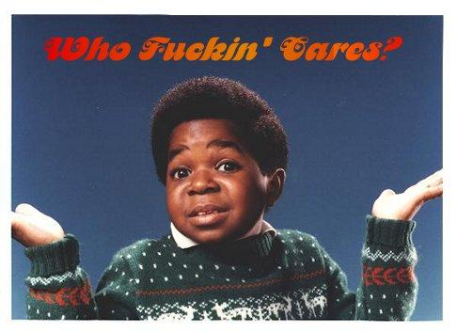
Why people do note to vote
Lack of interest
Failure to register
TO VOTE

Slide 7
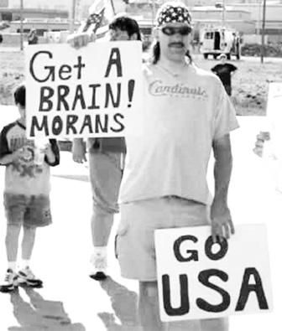
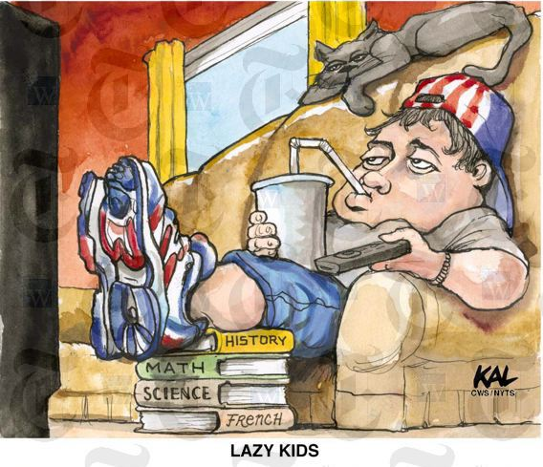
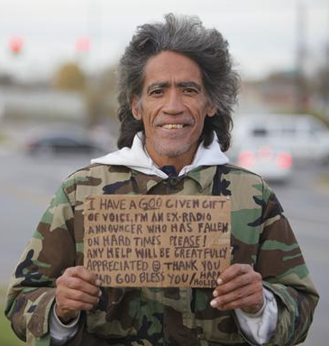
Who doesn’t vote
Age
  Young People
    Not interested
Education
  Uneducated
    Don’t understand the issues
Income
  Poor
    No time; other worries

Slide 9
Who?
Age
Young
Why?
Lack of Interest
&
Forget to Register
Education
uneducated
Income
Poor

